Slide 1
The Land Use Dialogue in the SAGCOT Ihemi Cluster: Background
November 2, 2016
Notes:
The purpose of this paper is to provide background for the initial Ihemi LUD engagements, explore the principles on which the LUD will be based, (IGG and landscape) and - based on the suggestions of the LUD stakeholders - identify potential issue areas of focus for the process.

Slide 2
Methodology
SAGCOT-wide
SAGCOT Investment Blueprint (2011)
SAGCOT Greenprint (2012)
SNAPP report: Encouraging Green Agricultural Development in the SAGCOT Region of Tanzania: Research Findings and Related Decision Support Tools
The Ihemi Cluster
SAGCOT Ihemi Cluster Development Framework
SUSTAIN Ihemi scoping
Great Ruaha Restoration Campaign Concept Note
Interviews with Tanzania LUD advisory

Slide 3
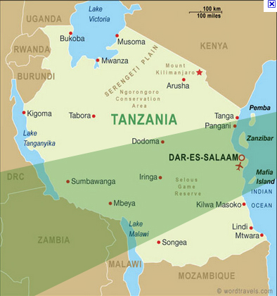
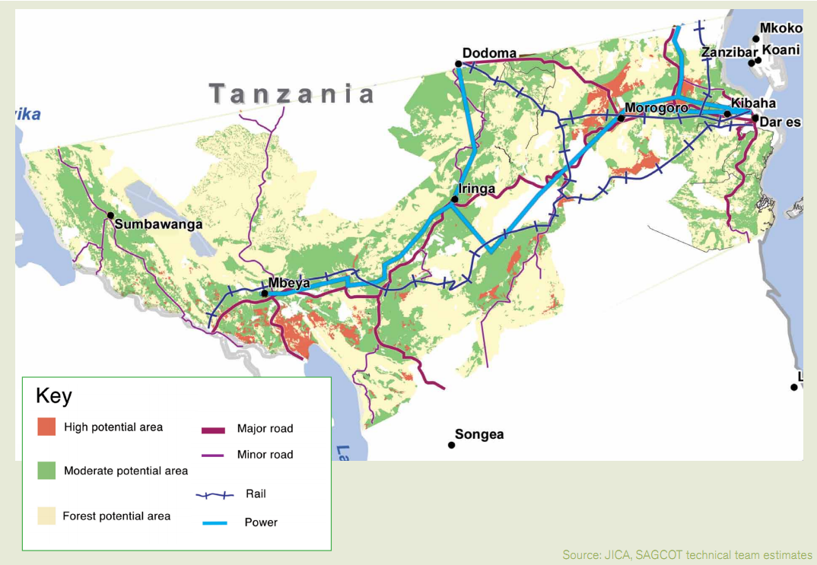
SAGCOT to build Tanzania’s granary
Notes:
SACGOT to build Tanzania’s granary

Slide 4
SAGCOT is an ecologically important region
Multiple ecosystems
High biodiversity value
Threatened by climate change
Notes:
Extensive protected areas and wildlife, with major tourism potential
Other critical natural areas, either not protected or ineffective/partial protection
Although adequate water in places, concern about climate change, with effects already being felt
Recognition of need for a new “climate-smart” ag development approach

Slide 5
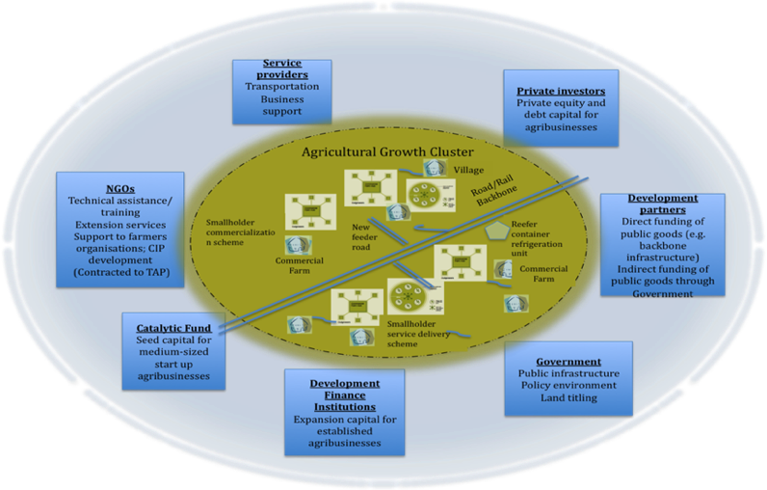
Leveraging investments and partnerships through clusters
Clusters are geographic concentrations of interconnected companies, specialised suppliers, service providers and associated institutiions
Notes:
SAGOT strategy is:
-public-private partnership
-focus on smallholders
-cluster approach
And the are going to leverage partnersh and investments through the clusters

Slide 6
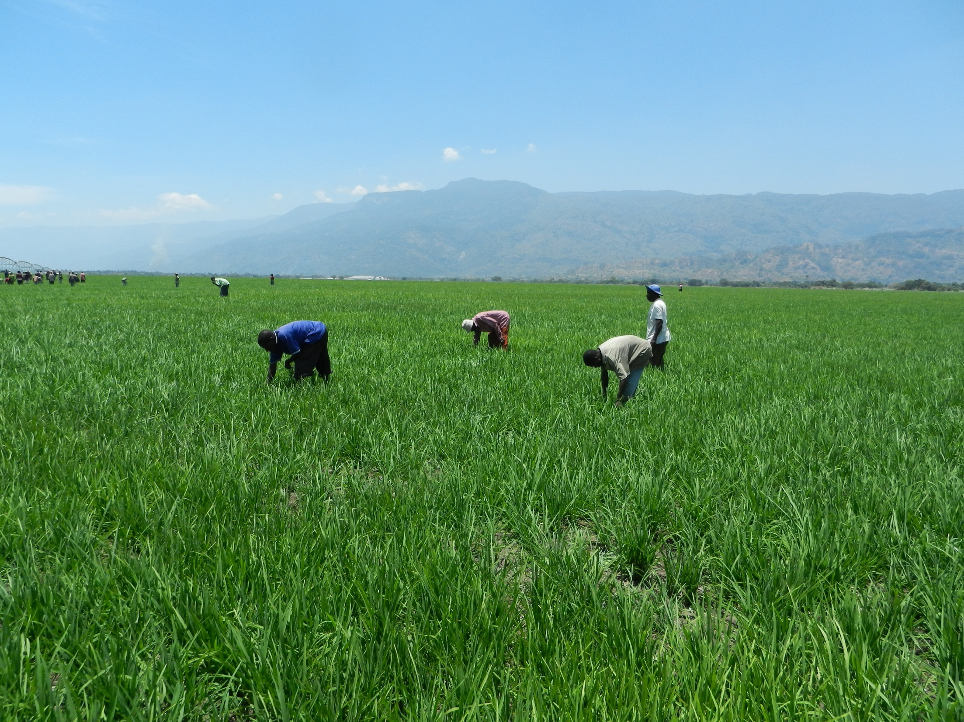
Inclusive Green Growth Objectives
Sustained agricultural productivity
Local and national food and livelihood security
Ecosystem conservation and ecosystem service delivery
Institutional capacity to support integrated management of agriculture, ecosystem and livelihood resources
Notes:
In order to do IGG at the cluster level you need a landscape approach

Slide 7
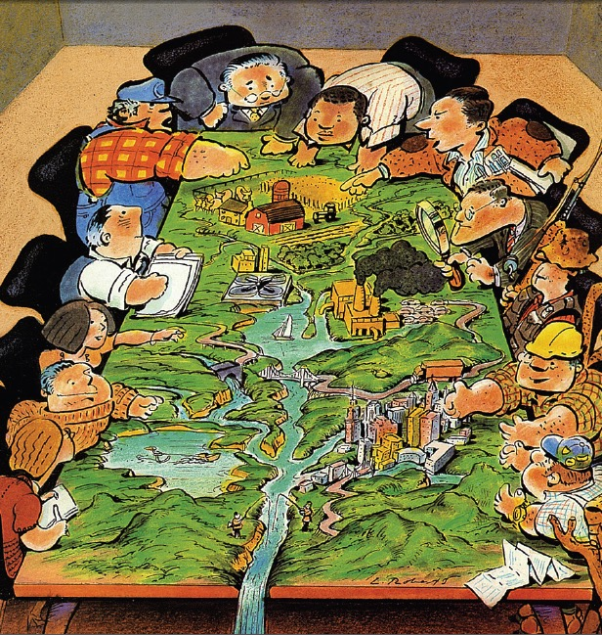
Landscape approach
Long-term collaboration among different groups of land managers and stakeholders to realize multiple objectives in a sustainable landscape
Notes:
Sustaining ecosystems calls for more than action at the plot and farm scale. We need to expand our frame to look at whole landscapes, and how the soil, water and vegetation resources being used by the many different land managers can be managed in a more coordinated way.
Spatially targeted and coordinated investment

Slide 8
Historical land governance
Photo: City of Curitiba (Secretariat of the Convention on Biological Diversity)
Notes:
So how do we achieve IGG? We can’t do this with old sectoral thinking. In many cases land is not managed to meet these objectives. Rather it is managed in a sectoral way.

Slide 9
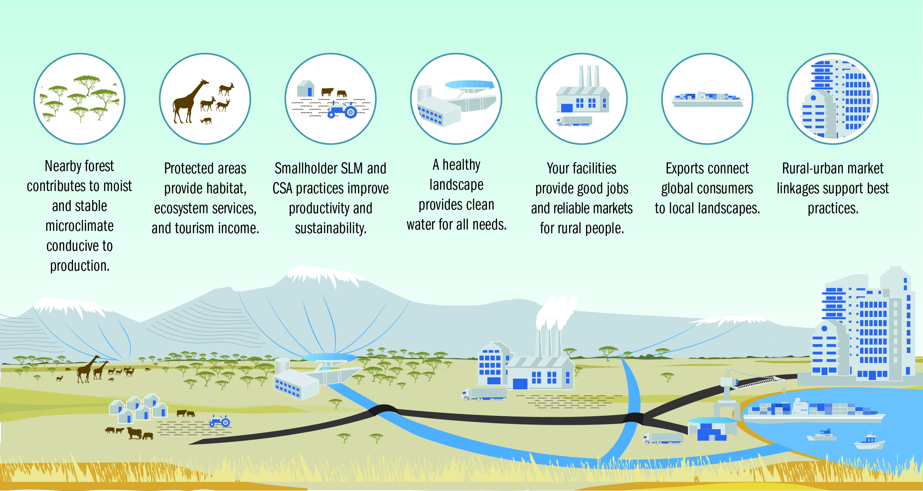
Interventions for an integrated landscape

Slide 10
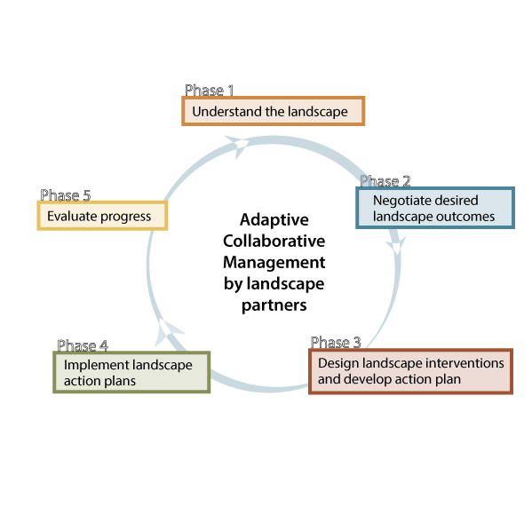
Partnership formation process
Notes:
How to make it happen? ACM is an on-going multi-stakeholder process that progresses through five main functions of assessing and understanding the state of the landscape to develop a common vision for change; negotiating specific desired outcomes to focus planning and management; planning and designing specific interventions; implementing activities to bring about the desired change; and evaluating the effectiveness of the actions for achieving the shared goals.

Slide 11
Integrated landscape initiatives across the globe
Source: The Little Sustainable Landscapes Book, 2015. Estrada-
Data from Carmona,et al (2014); Martin-Rubi,et al (forthcoming); Milder, et al (2014); Zanzanaini, et al (2015)
Notes:
There are a lot of models to learn from here.

Slide 12
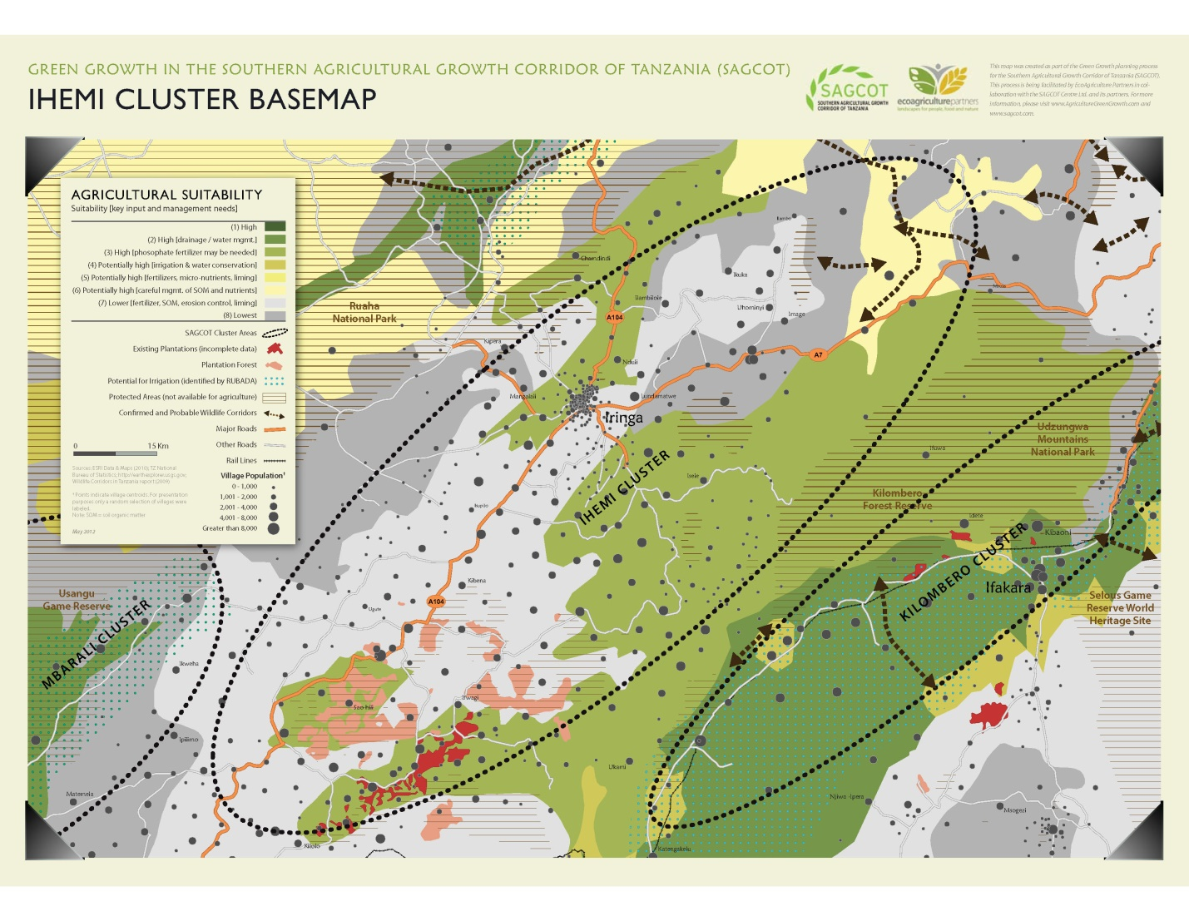
Photo: City of Curitiba (Secretariat of the Convention on Biological Diversity)
Notes:
This is a place that needs a landscape approach because there are challenges that transcend sectors. We saw that the last couple of days and we’re going to explore these challenges in more detail this afternoon. So let’s first get the basics of what the ‘landscape’ is
Location
-eastern part of Southern Highlands
-The Cluster includes parts of six districts covering Iringa Urban District and part of Iringa Rural, Kilolo and Mufindi, Wanging’Ombe and Njombe Urban and Rural Districts.
Population
-The population of the Cluster is just over 970,000 (see dots for village size) Iringa City, near center
-70-90 % of people in ag outside of Iringa Urban district
-Incomes are higher here than in most other parts of Tanzania except Dar es Salaam due to the productivity and diversity of the region’s agriculture and forestry industries (which I’ll get to later)
-HIV/AIDS prevalence is a serious challenge, with 16 % of the population affected
Infrastructure
The backbone road and power infrastructure reach the main city but, farther out, infrastructure is poor; this inhibits smallholder development
Land use
-one of Tanzania’s agricultural strongholds and an important region for forest and perennial crop production.
-almost 3 million ha, 2 million arable, about 47% is under cultivation
-average farm size of between 0.8-1.3 ha
-The region’s climate is unique in its heterogeneity, varying between the bimodal and unimodal rainfall patterns, which in turn results in diverse land uses.
-Forests, woodlands and mosaic cropping systems are the largest land uses in the Cluster.
-can also see some large-scale commercial tea and pulp wood plantations are in Mufindi District along the main highway from Iringa to Mbeya. (skip forward to table)

Slide 13
Land use patterns
Land cover | Area (sq. km.) | Per cent of total land
Artificial areas | 18.1 | 0.1%
Croplands (crops occupy >70% of area) | 213.8 | 1.5%
Mosaic croplands (crops occupy <70% of area) | 3,529.7 | 24.4%
Evergreen forest | 738.7 | 5.1%
Deciduous forest | 2,753.7 | 19.1%
Woodland | 2,724.0 | 18.8%
Shrubland | 3,232.4 | 22.4%
Grassland | 1,114.6 | 7.7%
Wetland | 115.0 | 0.8%
Total land area | 14,451.3 | 100.0%

Slide 14
Agriculture, livestock and commercial forestry
Iringa is the country’s leading region for potatoes and tomatoes
Important producer of tea, sunflower and processed fruits and vegetables
Climate variability effecting maize
Sunflower and simsim are maize alternatives
Livestock is second most important economic activity
Commercial forestry also important in future economic development
Notes:
First talk about the economic activities

Slide 15
Photo: City of Curitiba (Secretariat of the Convention on Biological Diversity)
Notes:
Forests and conservation
Forest types vary from managed to natural across the Cluster from more than 160,000 ha of montane forests high up, 1) the Udzungwa escarpment in Kilolo District -on southeastern edge of the cluster hold biodiversity - to 2) the lowlands in Iringa Rural District in the Northwest toward Ruaha National Park; crtitical to the hydrology of the Great Ruaha river catchment
-Along the southeastern edge of the Cluster, the diverse montane forests of the Udzungwa Mountains host critical biodiversity;
-Wildlife also depends on the large tracts of forests as well as on forest reserves across the Iringa highlands to function as corridors between Udzungwa and Ruaha National Parks.
-120 villages in CBFM and 50 in VLFRs
-Forests are in high demand, and deforestation driven by charcoal, fuelwood, timber and pulp (not conversion to ag)

Slide 16
Key questions to initiate a landscape management process
What does inclusive green growth look like to different stakeholders?
What institutional foundations are needed for inclusive green growth?
What national and sub-national policies are needed to enable inclusive green growth?
What are the most promising technical solutions for advancing inclusive green growth?

Slide 17
What does inclusive green growth look like to different stakeholders?

Slide 18
What institutional foundations are needed for inclusive green growth?
National level institutions (NLUPC, ASDP, WSDP)
SAGCOT Centre
Ihemi Green Reference Group
MVIWATA
Great Ruaha Restoration Campaign
Private Agriculture Sector Support Ltd
Notes:
-Need to effectively engage with existing governance structures both within and beyond the Cluster level
-Examples of effective local institutions and the strategies used to strengthen and support them, need to be documented, analysed and shared
-LUD will need to first identify and engage with the key institutions who are already working in partnership to support a landscape approach.
-Will need to understand the objectives of those groups and the key sensitive and contested issues and how they function
PASS-stimulates investment in commercial farming, is active in coordinating loans between farmers and Tanzania banks, most of which have financing windows for producer associations’ agricultural activities; Provides entrepreneurship training through farmers’ associations who demonstrate promise in commercialization.

Slide 19
What national and sub-national policies are needed to enable inclusive green growth?
Village Land use planning
District level planning
Ag sector development programme
Notes:
Land use planning
To reduce conflict, attract beneficial investment, and maintain a productive resource base for agriculture and protect environmental assets.
-Land use and land rights in Tanzania are governed by a complex and sometimes contradictory mosaic of policies, institutions, and planning processes. (we’ve probably hear this on field trip)
-can result in uncertainty for investors, too little protection for communities, and too little coordination among different sectors and investors that are each making their own plans.
-Village land use planning (VLUP) is one strategy currently being implemented to ensure smallholders and pastoralists benefit from growth
-authority to district governments to manage the VLUP process.
-VLUPs for only about 10 per cent of Tanzania’s villages.
-planning process and the plans themselves require financial and human resources that are lacking in many cases.
Sectoral land use planning (for agriculture, forestry, watersheds, wildlife, et al.) is also conducted through various ministries under multiple statutory authorities, but such plans are rarely integrated or harmonized to a meaningful degree.
District level planning
-At the district level, SAGCOT stakeholders could help local governments to support the commercial development of small scale farmers through District Agricultural Development Plans (DADPs), which receive finance from the Agriculture Sector Development Programme (ASDP).
-The District, in collaboration with villages, could consider developing a District Land Use Plan that outlines priority areas for agricultural production, forest conservation, protection of water resources, as well as strategies for dealing with growing and migrant populations.
-Would put district in a better position to advise villages and establish a coherent vision for IGG, and create partnerships with CSO facilitators
Agriculture Sector Development Programme (ASDP)
In 2006, the GoT unveiled its Agriculture Sector Development Strategy (ASDS) and corresponding Agriculture Sector Development Programme (ASDP). This Programme is targeted to meet local needs—and backed by participatory priority-setting exercises at the district level and by major financial commitments.
-A Phase 2 of ASDP is currently under development and the LUD could advocate for elements of this new phase that would support a landscape approach.

Slide 20
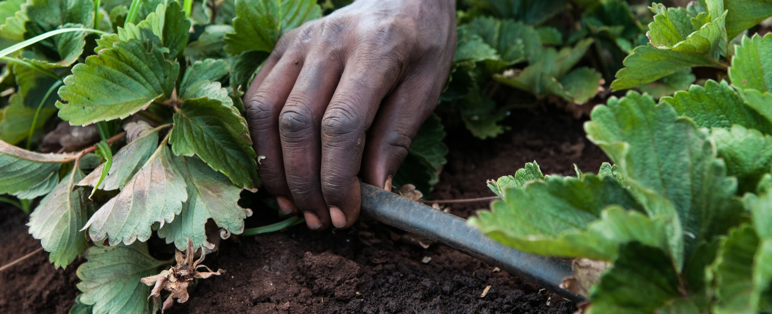
What are the most promising technical solutions for advancing inclusive green growth?
Sustainable agricultural intensification
Sustainable community forestry
Bioenergy production
Linking IGG to human health and well-being
Notes:
Sustainable agricultural intensification
–several strategies for more efficient use of new irrigation through precision technologies, reusing crop residues as field cover or livestock fodder, and improving the yields of smallholders, thereby establishing greater and more stable input supplies for local processors.
-Similarly, sustainable intensification of mixed crop and livestock systems in the highland region could lower producers’ input costs and reduce the potential for conflict over resources. The Sao Hill Cattle Ranch, Asas Dairy Farms and other large commercial livestock producers are ideally situated to begin introducing improved dairy and beef breeds, and serve as nuclei for extension of intensive livestock systems, inputs, range management and intensive fodder production. XXX other examples we see on field trip
-Many knowledge, technology, and input supply resources available in Iringa City, particularly if local expertise and knowledge hubs can be established in the rural areas. E.g. commercial tea plantations efficient modern irrigation systems. Needs capacity building
-In the lowlands, experimenting with transitioning some of their land from maize to sunflower to mitigate drought related crop failure (CSA)
-Need rapid roll-out of an enhanced agricultural extension programme…
Sustainable community forestry
-PFM since the passing of the Forestry Act in 2002. However, villages are only one of many actors in the forests.
-Tea and pulpwood producers manage large areas of forest land and contract with many villagers to augment their raw material supplies.
-A bigger challenge is to design PFM arrangements that link communities and commercial producers
-One option is to train local communities and develop nurseries to enable community members to plant and maintain high-biodiversity, carbon-rich mixed species plantations on both company and village lands.
-Conversely, large forestry companies can work with villages under the purview of PFM to commercialize new forest products for additional income streams. Need combined expertise for appropriate extension systems.
Bioenergy production
-Because of the high biodiversity value of its forests—and the intense pressure from wood fuel demand— Ihemi Cluster should be considered as a high priority for finance and technical assistance related to biogas development.
-There are additional opportunities to generate energy and fertilizer from recycling agricultural residues on large estates and processing wastes from the existing and planned processing facilities in and around Iringa City.
Linking IGG to human health and well-being
-Ihemi requires an integrated strategy that is sensitive to the social and health conditions in the Cluster.
-Coordinating extension activities with public health recommendations will be crucial.
-eg. promote the IGG strategies that help increase household nutritional diversity and require less labour -

Slide 21
Discussion

Slide 22
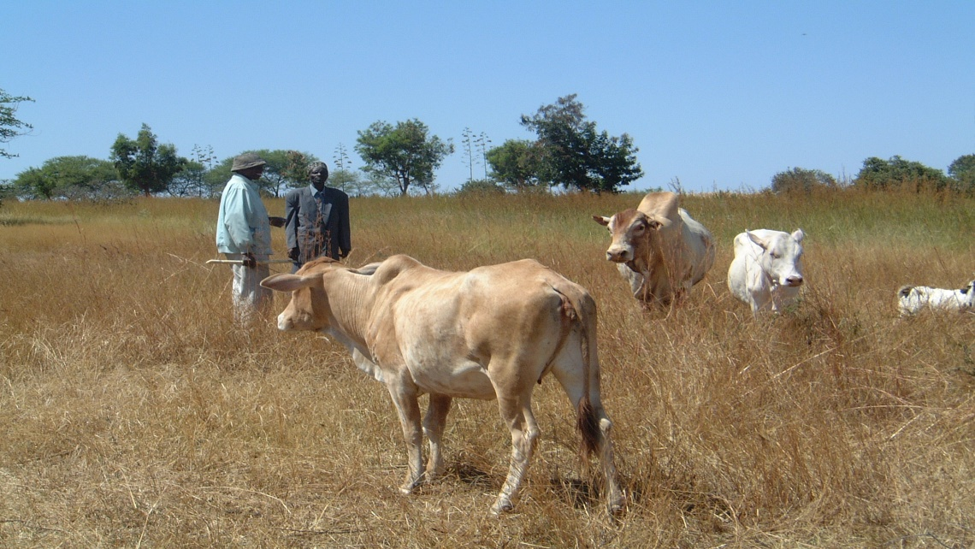
AGG Cropping and Livestock Systems Livestock management
Livestock management, to support integrated farming systems (small animals on farms), and to improve animal and pasture/rangeland productivity in extensive grazing systems.
Extensive + intensive
Photo by: The Bank of Natural Capital

Slide 23
A Landscape
A socio-ecological system that consists of natural and/or human-modified ecosystems, and which is influenced by distinct ecological, historical, economic and socio-cultural processes and activities.

Slide 24
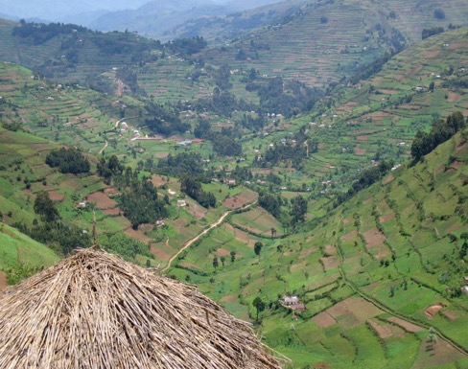
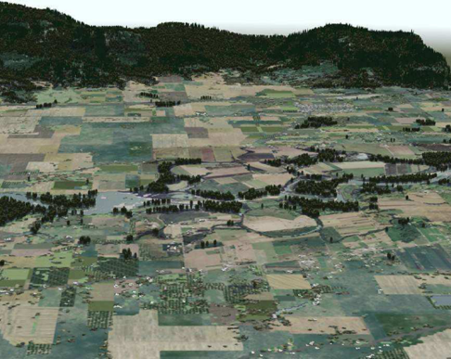
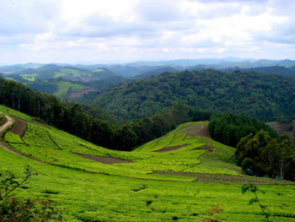
ILM has evolved from diverse entry points
Uganda
USA
Kenya
Integrated watershed management
Landscape restoration
Territorial development
Model forests
Agricultural development corridors
Socio-ecological landscapes
Terroire
Biological corridor
+75 other communities of practice

Slide 25
PARTNERSHIP & LEADERSHIP
Government of the United Republic of Tanzania
SAGCOT partners include major actors from all relevant stakeholder groups.
SAGCOT is supported by President Jakaya Kikwete, donor groups and many private sector actors.
Donors and development finance institutions
Local and international private sector

Slide 26
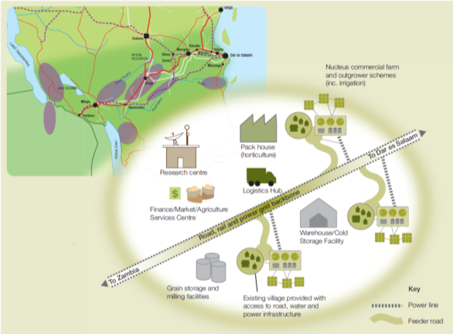
HUBS & CLUSTERS
Clusters of agricultural projects are centred around logistical and infrastructure hubs, maximising efficiencies and promoting economies of scale.
These projects will include:
Production
Storage
Processing
Research
Associated service providers
SAGCOT has identified six priority clusters
Notes:
SAGOT strategy is:
-public-private partnership
-focus on smallholders
-cluster approach
And the are going to leverage partnersh and investments through the clusters

Slide 27
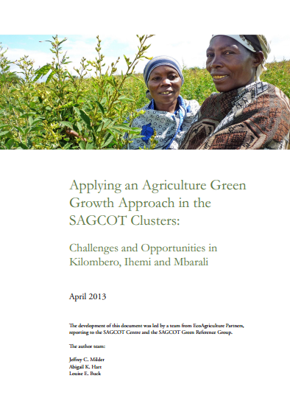
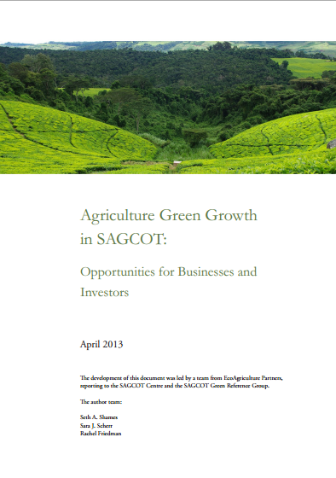
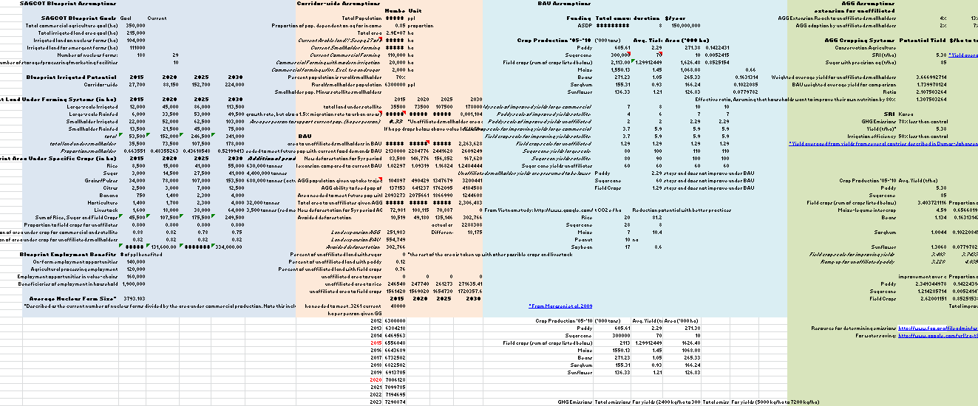
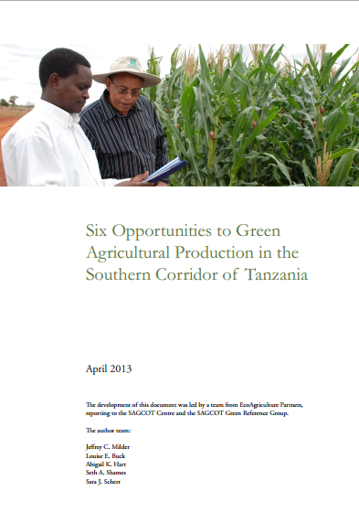
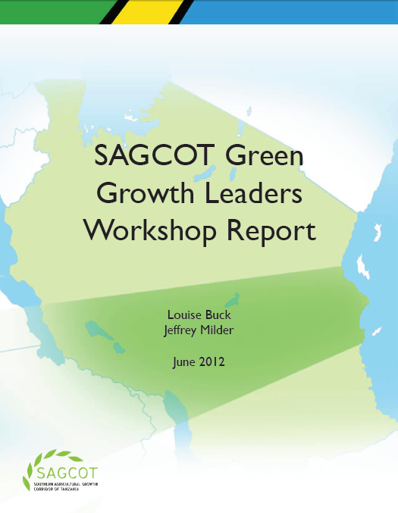
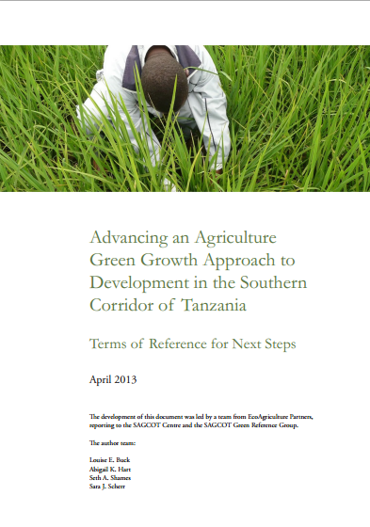
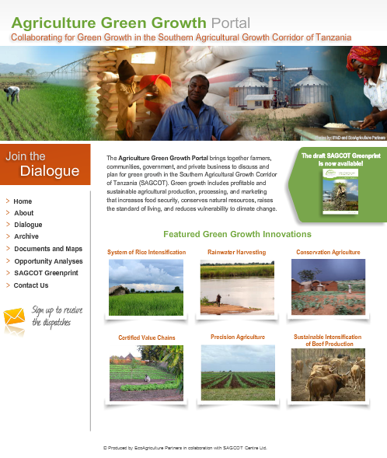
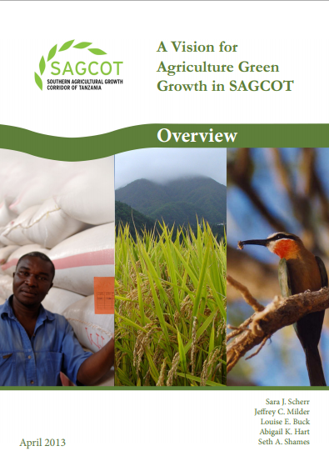
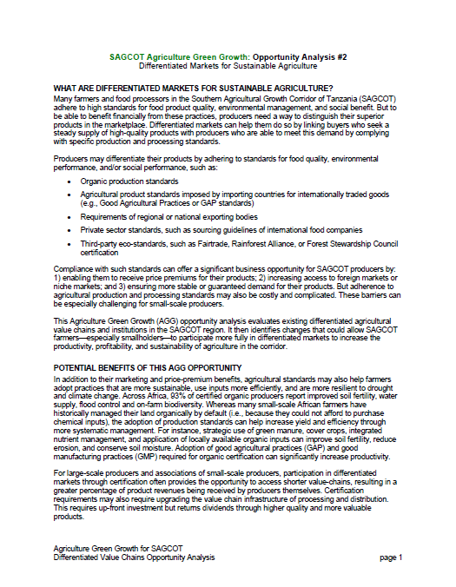
SAGCOT
AGG scenario model
Cluster situation analyses
Opportunity analyses
Workshop materials
Portal
SAGCOT AGG Greenprint Reports
Notes:
The IGG Vision included four separate reports –the full Greenprint, a special report on private sector investment strategies, a description of six promising AGG opportunities and introducing the AGG approach into Cluster-level development. We also produced an Overview of the Vision and a set of Next Steps for moving into action. Also included specific analysis of Ihemi

Slide 28
Key features of ILM
Shared or agreed management objectives that encompass multiple benefits from the landscape
Land use practices contribute to multiple landscape objectives
Manage the synergies and trade-offs among objective and land uses across the landscape
Markets, policies and programs are shaped to achieve the diverse set of landscape objectives
Collaborative processes for multi-stakeholder governance

Slide 29
Why a Landscape Approach?
Threats to water important to key stakeholders
Social conflicts over natural resources
Landscape-scale environmental catastrophe
Operational risks for agribusinesses
Threats to human health of influential groups
Notes:
There are certain places that cannot be effectively managed with sectoral-based thinking
150 years of dividing up the landscape for different uses, managed by different people
Meet food & fiber demand for 9 billion people (↑50-100% by 2030)
Reduce rural household & community food insecurity poverty
Secure suply for rising urban populations
Adapt production to climate change
Restore degraded resources critical for production
Contribute to and restore critical ecosystem services, incl. fresh water
Shift land use from a major source of greenhouse gases, to a net sink
Contribute to sustainable energy

