Slide 1
Co-chairs summary from Wednesday discussion

Slide 2
Notes from group work
Developing of a common understanding of IGG and need to understand each other (develop trust)
Monitoring greenprint (what are we learning?)
Harmonizing policies (review processes)
Involvement of actors – participation and inclusiveness

Slide 3
Notes from group work
Coordination of initiatives – role of platforms to bring all stakeholders together
How do we move from small projects to scale – how do we achieve a landscape approach
Improved efficiency of use of natural resources
Who bares the cost of the landscape approach (roles and responsibilities)

Slide 4
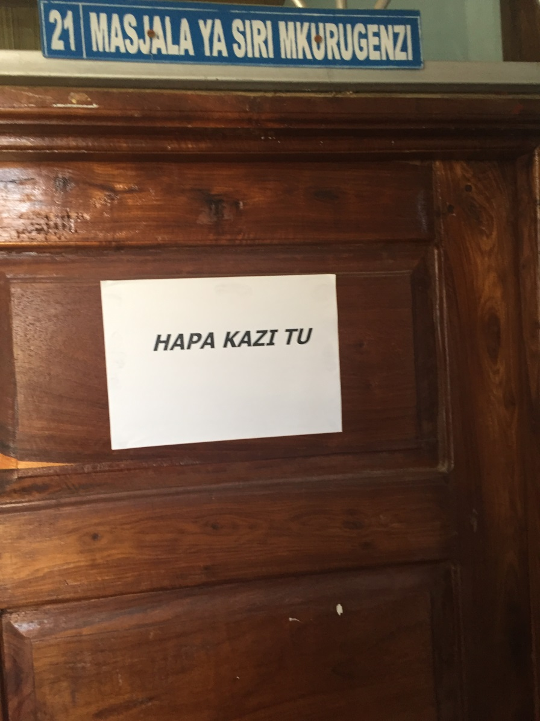
Reflections

Slide 5
Thursday morning
Building on existing initiatives and to address the issues raised:
What key tasks need to be undertaken
What key stakeholders need to be involved
What would be the source of funding
How can we use those to influence policy

