Slide 1
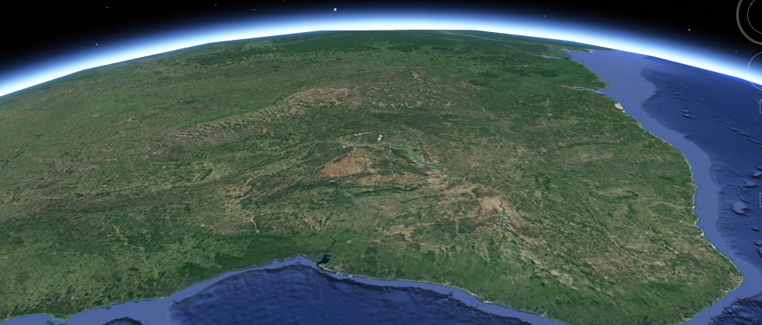
Engaging the private sector to support ecosystem conservation and restoration
Increasing biodiversity in Southern Bahia, Brazil
TFD – The Forests Dialogue
Authors: Daniel Piotto et al.

Slide 2
Global context and frameworks
Global biodiversity and climate crisis
Ecosystem restoration as a nature-based solution
UN Decade on Ecosystem Restoration (2021–2030)
Global Biodiversity Framework
Bonn Challenge

Slide 3
Global challenges
Implementation gap
Financing limitations
Monitoring challenges

Slide 4
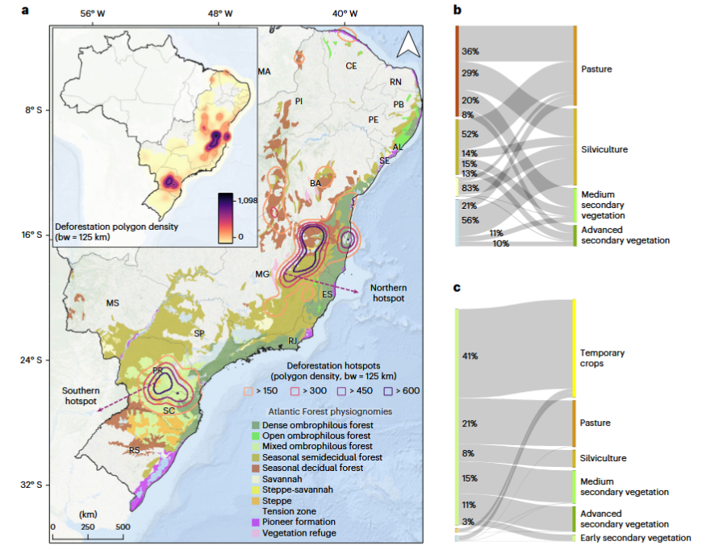
Atlantic Forest restoration
Atlantic Forest Restoration Pact
Landscape-scale action
Private lands
Legal framework

Slide 5
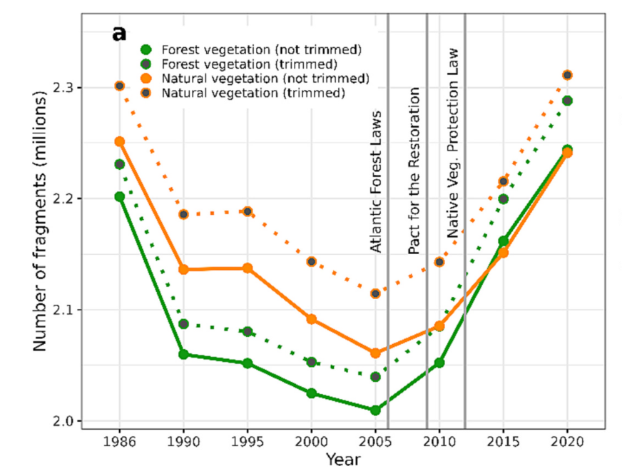
Atlantic Forest restoration

Slide 6
Why Southern Bahia?
Central Atlantic Forest Corridor
High biodiversity and fragmentation
Working landscapes – private lands

Slide 7
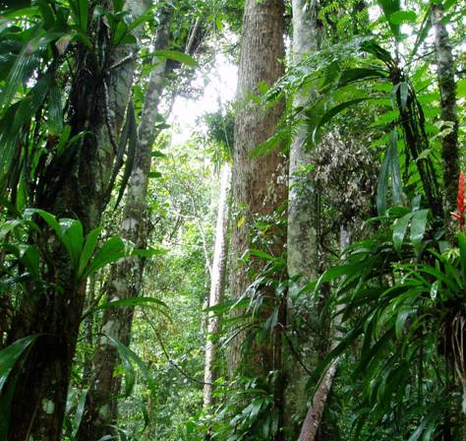
Ecological importance
Global biodiversity hotspot
High endemism
Potential for landscape connectivity

Slide 8
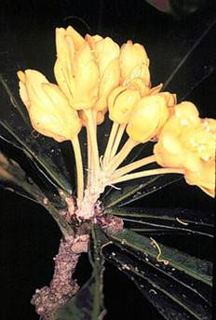

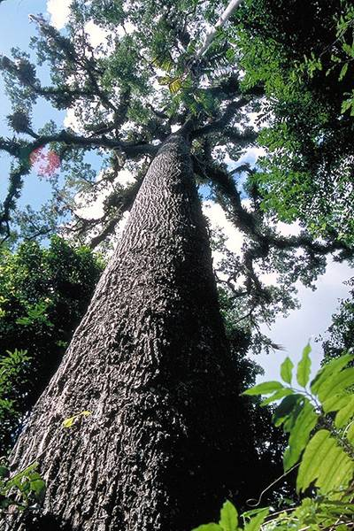
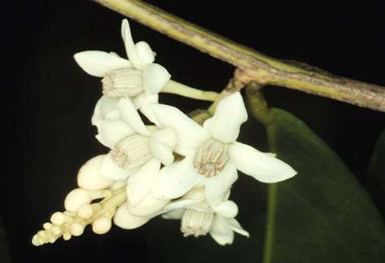
Moist forests
Cariniana
legalis
Capparis
bahiabella
Nematanthus
corticola
Harleyodendron
unifoliolatum

Slide 9
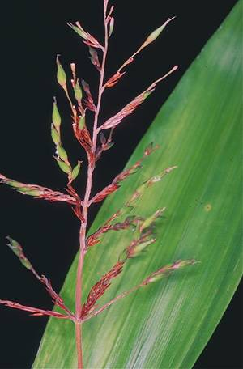
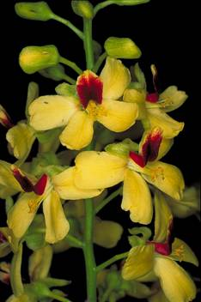
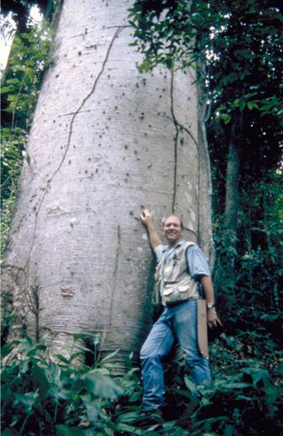
Decidual forest
Caesalpinia echinata, Pau-brasil
Sucrea monophylla, endemic bamboo
Cavanillesia arborea

Slide 10
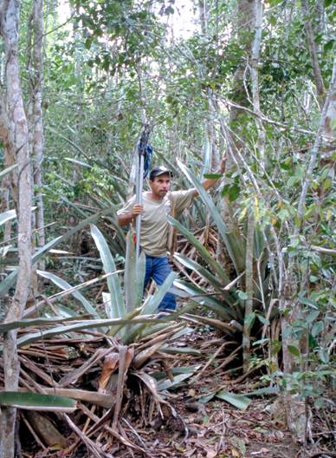
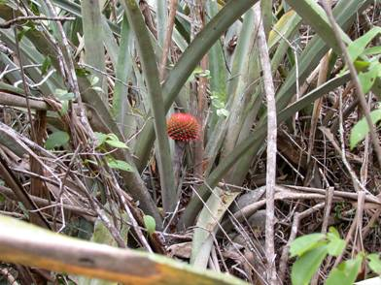
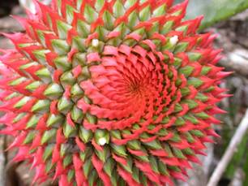
Dry forest

Slide 11
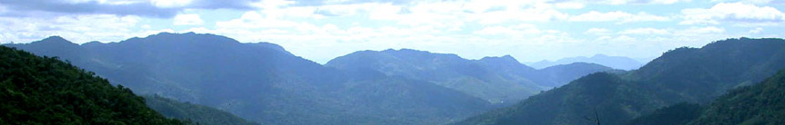
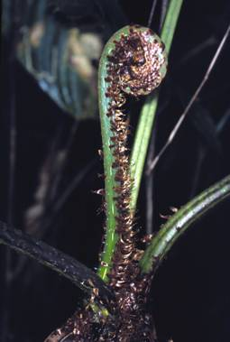
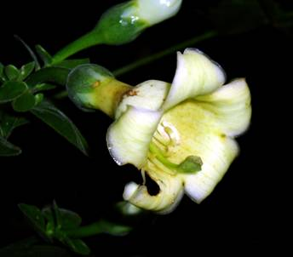
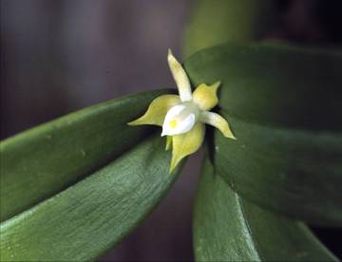
Mountain forest
Macrocarpaea obtusa
Orchid, Prosthechea pygmea
Tree fern Cyathea

Slide 12
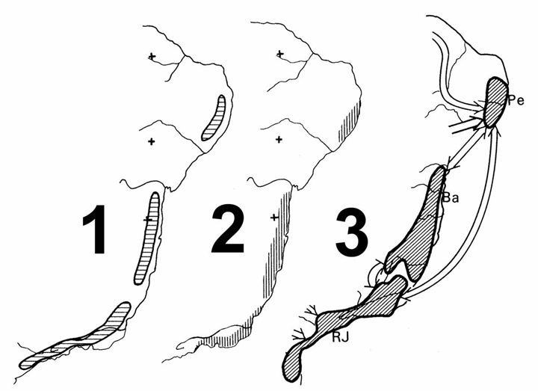
Endemism
Plants Birds Butterflies

Slide 13
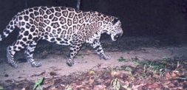
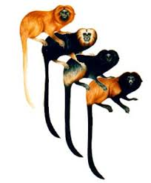
Wildlife
Leontopithecus spp.
Small and cryptic animals
39% of mammals are endemics
15% of Brazilian primates inhabit the Atlantic forest, most endemics
Very high number of threatened species

Slide 14
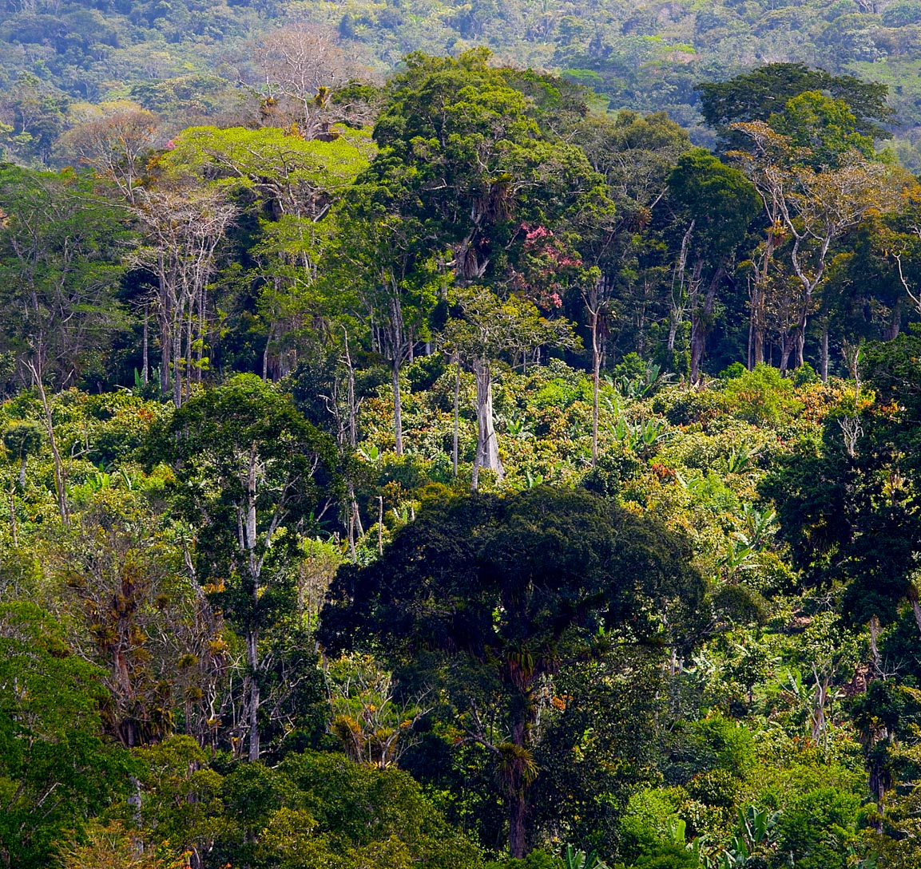
Agroforests
500.000 ha of cocoa agroforestry
Cocoa introduced in 1750
Endangered habitat
Knowledge gaps

Slide 15
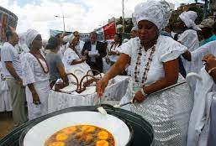
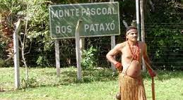
People and culture
Quilombolas (Afro-Brazilians)
Indigenous peoples
Rural settlements

Slide 16
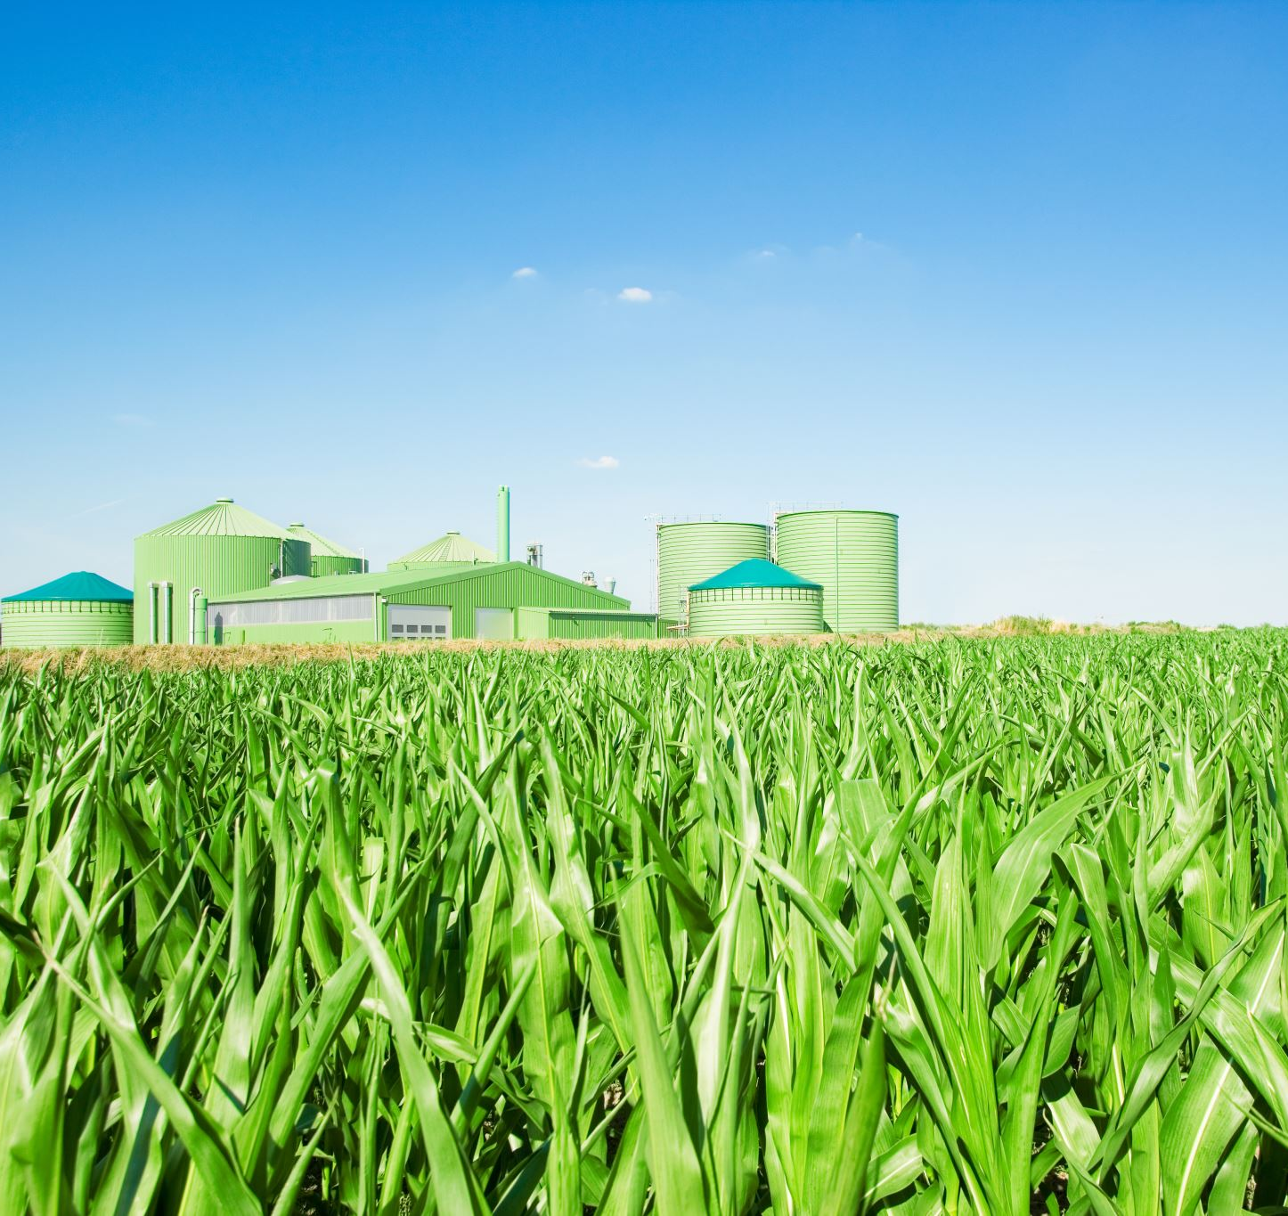
Anthropogenic disturbances
Urbanization and land use change
Timber exploitation
Agriculture and livestock: e.g. coffee
Extractivism
Hunting
Climate change
Invasive alien species: e.g. Acacia spp.

Slide 17
Some fracture lines in restoration
Economics vs ecological integrity
Carbon vs biodiversity
Top-down vs bottom-up

Slide 18
Restoration as a social process
Indigenous and traditional communities
Historical conflicts
Governance and trust

Slide 19
Role of the private sector
Capital mobilisation
Land stewardship
Innovation

Slide 20
Forest-sector contributions
Direct restoration
Integrated production systems
Landscape approaches

Slide 21
Restoration finance
Public funding
Blended finance
Carbon and biodiversity credits

Slide 22
Monitoring and MRV
Ecological indicators
Social outcomes
Transparency

Slide 23
Conclusions
Restoration is essential
Private sector is necessary but not sufficient
Governance and inclusion are critical

