Slide 1




Ecosystem Restoration Field Dialogue
Bahia, Brazil
4-7 May 2026

Slide 2
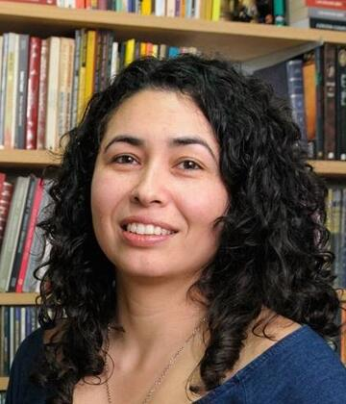
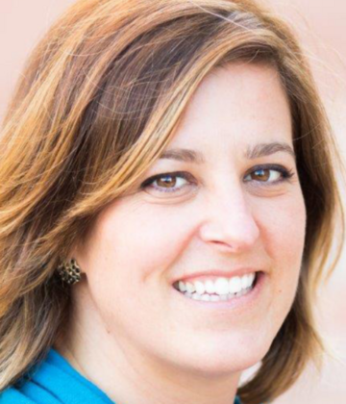
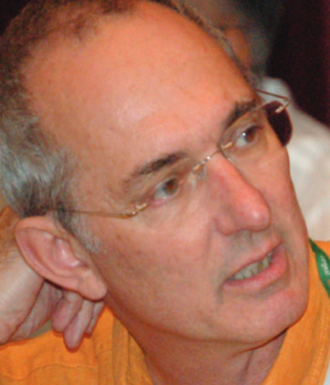
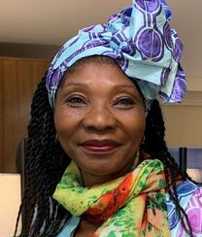
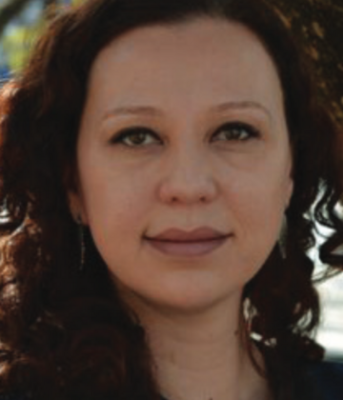
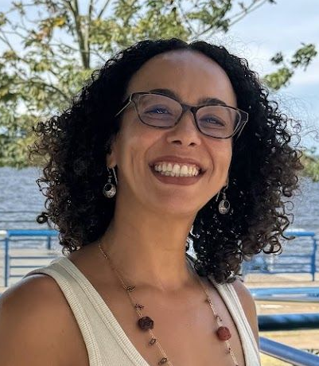
Dialogue Co-Chairs
Maurem Alves
Klabin
Kerry Cesareo
WWF
Marcus Colchester
Forest Peoples Programme
Fernanda Rodrigues
Brazilian Forests Dialogue
Erica Munaro
Bahia Forest Forum
Cécile Ndjebet
REFACOF
+ Support from the TFD Team (Logan, Isabela and Gary)
Brazil Forest Dialogue and Bahia Forest Forum(Vitor and Marcia)

Slide 3
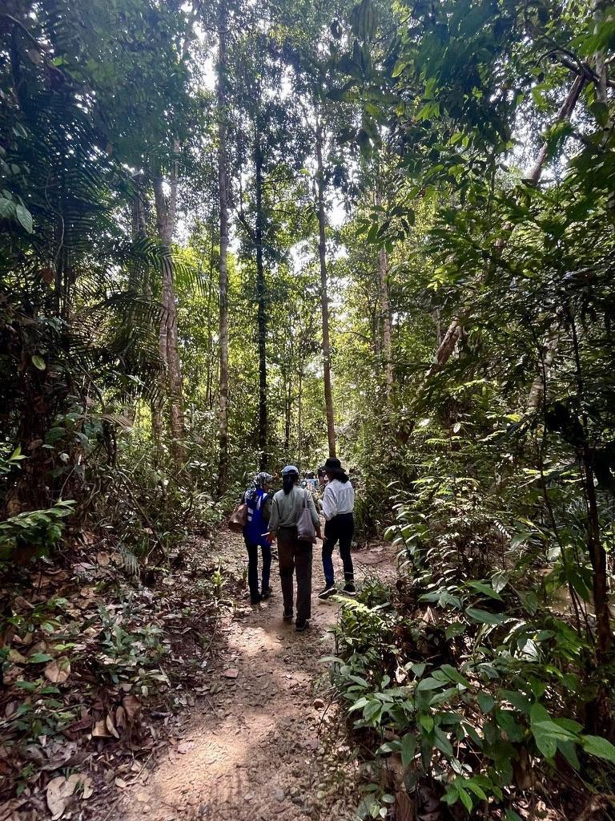
Dialogue Ground Rules
TFD operates under the Chatham House Rule
“Participants are free to use the information received, but neither the identity nor the affiliation of the speaker(s), nor that of any other participant, may be revealed.”

Slide 4
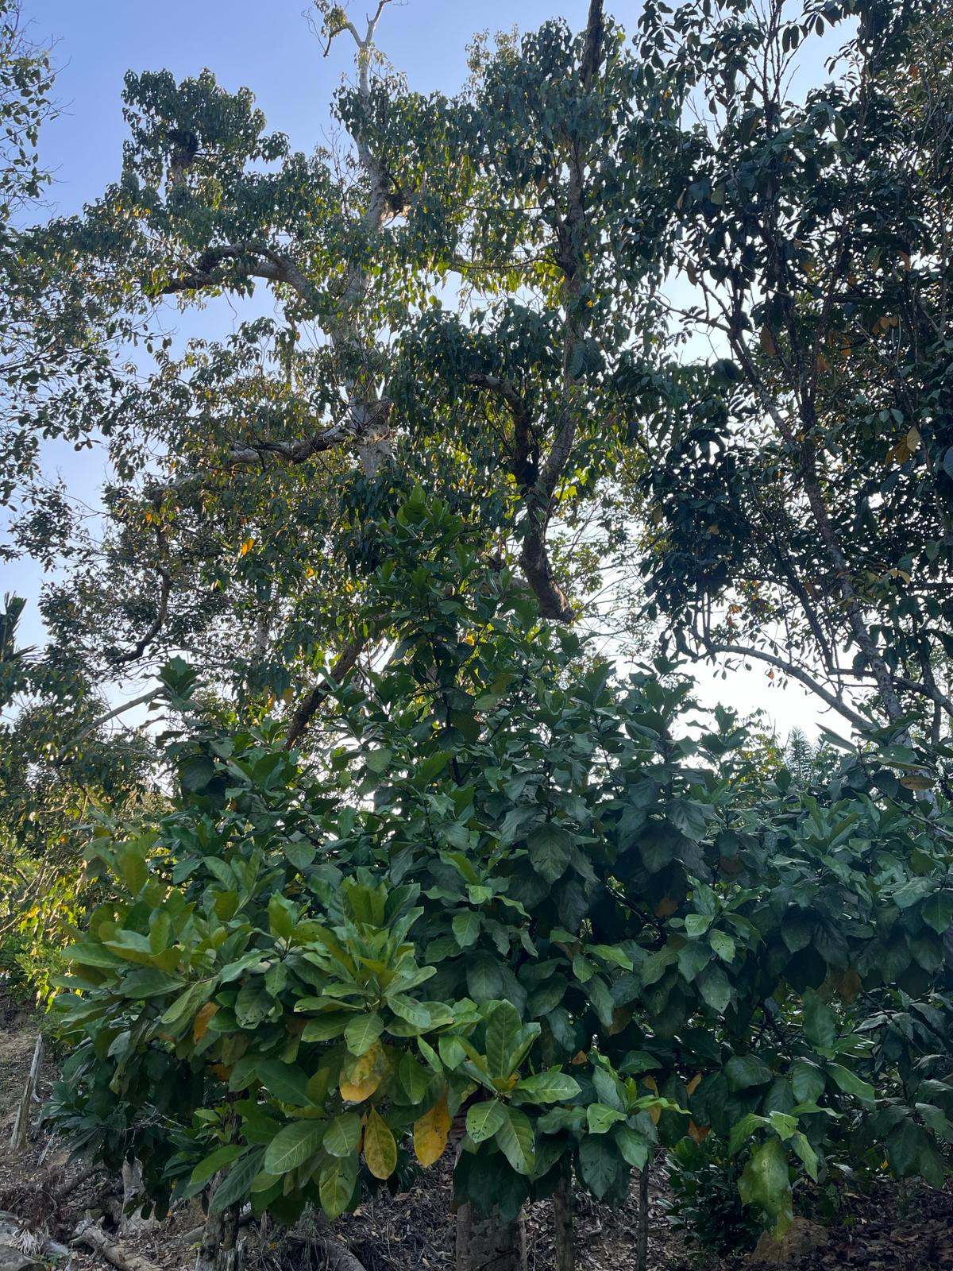
Dialogue Ground Rules
Engage in the “spirit of dialogue”
Practice active listening
Participate as individual
Take space, make space
Help define and own the outcomes
Use structured interventions in plenary- name tent

Slide 5
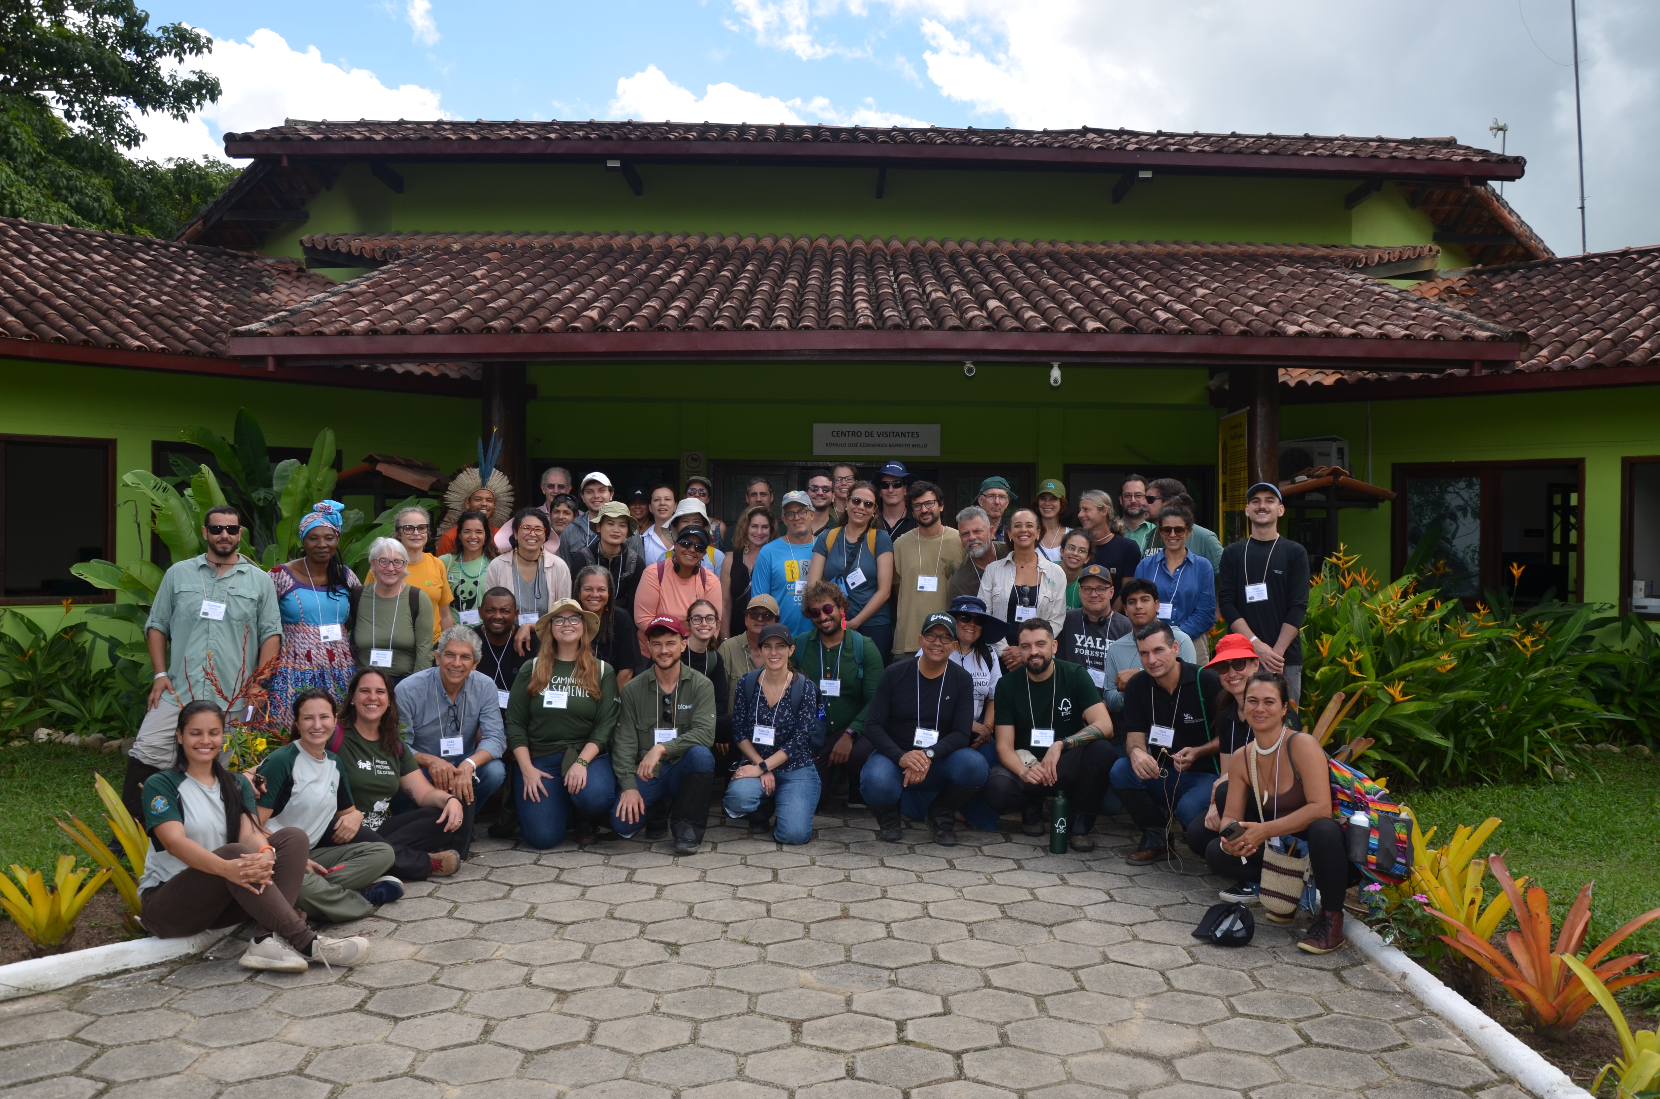
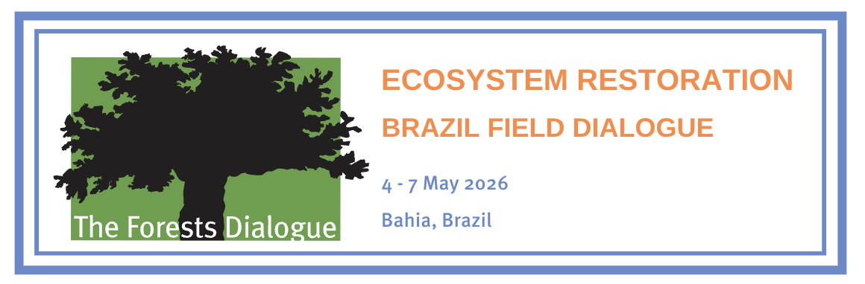
Co-Chairs’ Initial Summary:
TFD Field Dialogue on Ecosystem Restoration
The Forests Dialogue, Brazilian Forests Dialogue, and Bahia Forest Forum
Bahia, Brazil 4-7 May 2026

Slide 6
Reminder of Objectives
Clarify ecosystem restoration needs and engage broad range of stakeholders in Bahia
Understand how private sector can better support forest restoration and engagement
Explore opportunities for collaboration: partnerships with communities, political support, policy clarity, finance, traditional rights recognition, inclusion of Indigenous Peoples (IPs) and women
Examine key success factors and challenges in local context

Slide 7
Identified ‘Fracture Lines’
(from Background Paper)
Ecosystem Restoration or Reforestation
Promoting Restoration or Stopping Deforestation
Controversies about Financial Systems
Ensuring Benefits for Other Land Users
Top-Down versus Bottom-Up Initiatives
Notes:
Bullet Point Three: Controversies about Financial Systems carbon markets, credits, payments and biodiversity markets, credits, payments
Bullet Point Four: land tenure and carbon rights for Indigenous Peoples, quilombola (maroons), small farmers and land reform beneficiaries

Slide 8
Challenges and Opportunities
(from Background Paper)
Pilot Projects to Landscape Scale: Tenure, Governance and Finance Challenges
Private Lands and Atlantic Forests (AF) (90% AF on private lands)
Pasture Land to Pulpwood Plantation Pipeline
Forest Code: Permanent Preservation Areas (PPA) and Legal Reserves
Agroforestry and Cabruca System
Government Policies Impact on Finance Mechanics (e.g. Payment for Ecosystem Services or PES)
Notes:
Bullet Point Two: 90% of remaining Atlantic forests are on private lands
Bullet Point Three: Some pasture lands (main cause of past deforestation) are being converted to pulpwood plantations, which seek to obey Forest Code
Bullet Point Four: Laws require land-owners to establish Permanent Preservation Areas and 20% Legal Reserves, which gives scope for restoration efforts
Bullet Point Five: Making the most of agroforestry and local knowledge: eg building on the cabruca system (cacao cropping as forest understory)
Bullet Point Six: government policies, such as PES scheme and GHG Emissions Trading System can incentivise restoration

Slide 9
Social Considerations
(from Background Paper)
“Successful ecosystem restoration depends fundamentally on effective collaboration among diverse stakeholders. These include scientists, policymakers, non-governmental organizations, the private sector, indigenous peoples, and local communities, as well as elders, religious leaders, women, and youth, whose knowledge systems and social roles are increasingly recognized as essential for long term success.”

Slide 10
History of Land Conflicts in the Landscape
Until mid C20th region was mainly occupied by originarios, quilombola, nativos : most land was untitled
1950s Land Takeover mainly by Ranchers / Large landowners
Rural violence (e.g. cowboys shooting Pataxo)
Incoming companies bought lands from these ranchers
Resentment and Land conflicts between landowners/private companies and IPs, maroons and Movimento Sem Terra (MST).
Companies slow to recognise claimants’ rights pace (in spite, success)
Notes:
Bullet Point One: Until mid C20th region was mainly occupied by originarios (indigenous peoples) and quilombola (maroons) and nativos (local communities: most land was untitled and rights were not recognised
Bullet Point Two: Large Landowners – mainly ranchers - took over a lot of land without considering prior land users
Bullet Point Five: Resentment against companies is pervasive and there are many land conflicts between landowners and Ips maroons and mst
Bullet Point Six: Companies have been slow to recognise any claimants’ rights but some IPs, quilombola, reservas extractivista and land reform recipients have secured small areas

Slide 11
Governance Challenge for Bottom-Up Restoration
NTFP collectors (extrativistas) have to negotiate with Ministry of Environment (MoE) to get reserves
Agrarian reform claimants have to organise as collective and seek title from INCRA which is under Ministry of Agrarian Development
Maroon communities (quilombos) have to make claims to Fundacion Palmares, even to secure tiny areas, which is under Ministry of Justice
Indigenous Peoples have to make claims through the Fundacion Nacional do Indio which is under the Ministry of Indigenous Affairs
The multiplicity of line ministries that handle land tenure makes landscape restoration (eg for corridors) very complicated

Slide 12
Site #1: Fabio Santos Pre-Settlement
Previous Owner was Coffee Farmer (largely abandoned)
MST, led by women, occupied the land
Much of the land was acquired by Fibria, some remained with coffee farmer
MST opposes monocrops, Eucalyptus, and blocked Fibria having access.
Suzano bought Fibria
Notes:
Bullet Point One: This land was held by coffee farmer but was largely abandoned

Slide 13
Site #1: Fabio Santos Pre-Settlement (Cont.)
Professor from University of Sao Paulo brought in to mediate dispute:
Mitigation agreement reached
  established the Agro-Ecological School
  agreed partnership including MST, Suzano, iNovaland and FASB
  Suzano voluntarily agrees to relinquish land
  INCRA asked to title – very long process underway
Restoration, notably in riparian reserve (corridor), being paid for by Suzano, falls within area being titled to settlement by INCRA
MST in Fabio Santos oppose forest carbon market and agrochemical use, making weed control challenging
iNovaland also has restoration projects elsewhere with indigenous reserves and quilombos
Notes:
Bullet Point One: This land was held by coffee farmer but was largely abandoned

Slide 14
Site #2: Suzano Restoration
40% of Bahia is still held by ranchers as pasture
The demo area was held by a cattle rancher → Suzano bought the area from a rancher in 2001
Forest Code became law in 2008 which requires:
  That 20% of land title be forested or restored within 30 years
  Riparian areas and steep slopes be kept forested/restored
Suzano started restoration initiative in 2010 (pre-2012 law becoming effective)
Complex planning process with MoE to authorise restoration plans
There are options for interplanting agroforestry / crops including eucalyptus for financing restoration
150 Suzano staff now doing restoration at scale planting 80 spp
There is discussion about whether restoration is voluntary or mandatory and therefore whether there is additionality or not for carbon credits

Slide 15
Site #3: Pau Brasil National Park
ICMBio manages NP which includes conservation and restoration
Area was originally Pataxo Ha Ha Hae indigenous territory
Forest fragmented by ranches, pepper farms and Eucalyptus plantations. Pataxo forced out.
Core protected area was declared in 1999 and area extended in 2010

Slide 16
Site #3: Pau Brasil National Park (Cont.)
PBNP: Organization-Wide Action Now
  1) Currently in discussion with surrounding farms/plantations in NP for buffer zone
  2) was exclusionary but now reaches out to local communities and provides services and benefits in terms of environmental education, employment as guides and fire brigades
  3) A network is now being establish to monitor and prevent illegal logging
Site Process
  2021/2022 ENGO Natureza Bela carried out forest restoration with local people as main employees in partnership with CI& Mastercard and Veracel (not seeking carbon credits) and ICMBio
  Labour intensive to weed out grasses (and ferns) to let seedlings grow.
  Employment policy encourages men and women. Pay is above minimum wage.
  Seed collection for nurseries done by trained local people.

Slide 17
Site #4: Symbiosis
Pioneering project seeking to make planted native forest restoration commercially viable with 50% conservation and 50% SFM logging
Idea started 2008. Land acquired from rancher 2010
Initiated with 56 now 12-13 spp.
  Experiments show fertilizer and lime markedly accelerate growth
  Native spp as responsive exotics
Expanding with more land being purchased and leased
Impressive nursery producing 5 m seedlings pa from seeds and through cloning (both stem and rootstock clones): selecting for resilience, productivity, straight trunks and disease resistance
Seed collection by locals and MDPS
  Some spp from other parts of Brazil.
Initial areas certified by FSC; credits certified by VERRA

Slide 18
Site #4: Symbiosis (cont.)
Now 50/50 joint venture with Apple Restore Fund with CI and Goldman Sachs
Mill being established for added value with extensive reuse of ‘waste’
Mill capacity is 10,000 m3/year with target growing area of 70,000 ha
  Can also process off farm rubber, eucalyptus and African mahogany.
Engaging with the local communities to identify their priorities and concerns – social situation is challenging
  Provide jobs, policy of inclusion, 86% people of colour, 65% women
  Gender justice awareness-raising being brought back into the villages.
No land disputes with IPs in their areas but working with IPs on seed collection
  Other IPs nearby do have problems securing reserves.
Government bureaucracy is onerous, especially as regulations designed to control natural forest logging.
Business plan is to make planting and logging profitable with carbon as premium
Initiative now being copied in other parts of Brazil
Scope for Government to provide incentives (tax breaks)
  e.g. coffee, steel, mill, tax breaks

Slide 19
The Monitoring Challenge
Monitoring by whom? Whose visions and perspectives really count?
Monitoring what? Who sets the outcomes being sought? How ensure consensus first?
Monitoring against what? What are the baselines – status quo today, situation in 1500, 1750, 1950 etc
Monitoring the process and not just results.
Need to include more about community perspectives, indigenous and traditional knowledge and community-based monitoring tools.

Slide 20
Further Reflections
What potential synergies have not yet been explored?
  For example, where could organizations working on similar aspects of restoration collaborate more strategically to increase impact?
Are we asking the right questions about the barriers to scaling up restoration?
What critical challenges might we be overlooking—whether technical, financial, social, or governance‑related?
What is the role of forestry in restoration, particularly for scaling up?
  What is the space for innovative forestry business models to rise to this challenge?
From the cases presented, what clearly worked well—and what did not?
What lessons can we extract that are transferable or should explicitly not be replicated? Do we have other references to be used?
What does “scaling up” restoration really mean for us?
  Are we aiming for a single, replicable large‑scale model, or a diverse set of locally adapted initiatives—and what are the implications of each approach?

Slide 21
