Slide 1




Ecosystem Restoration Field Dialogue
Bahia, Brazil
4-7 May 2026

Slide 2
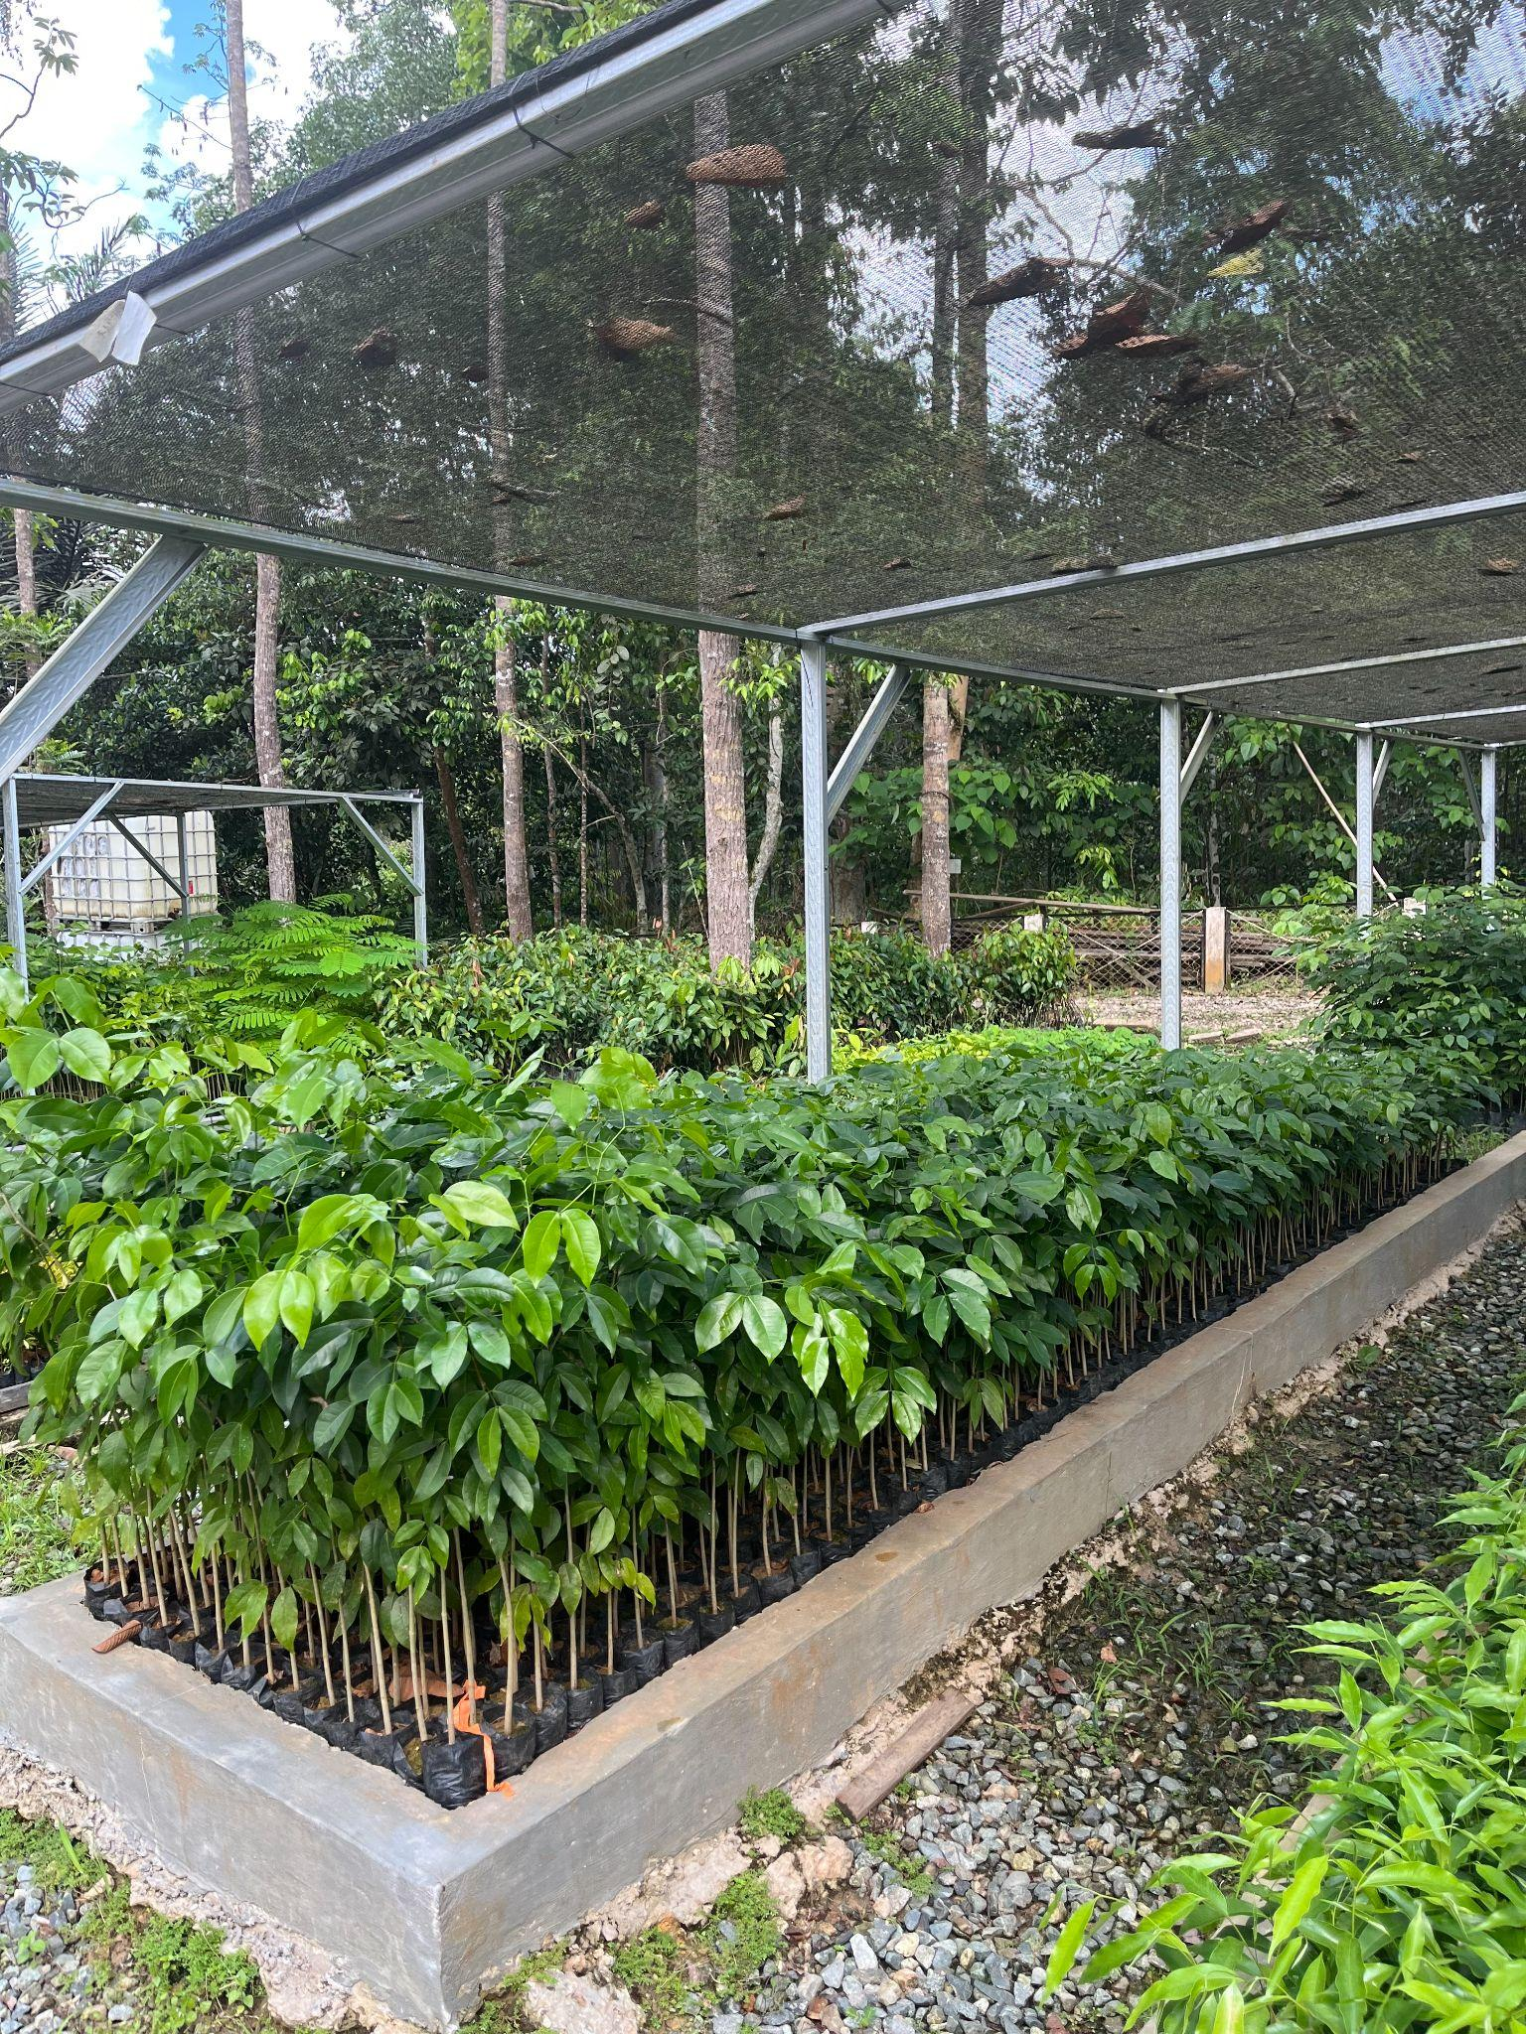
Monday 4 May
19:00 Welcome remarks and Dinner
20:15 Presentations
  Dialogue introduction and ground rules
  Background paper presentation
  Field visits overview
21:00 Adjourn

Slide 3
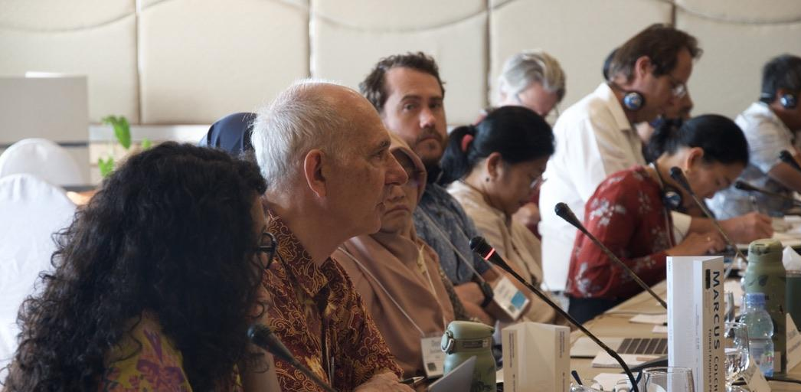
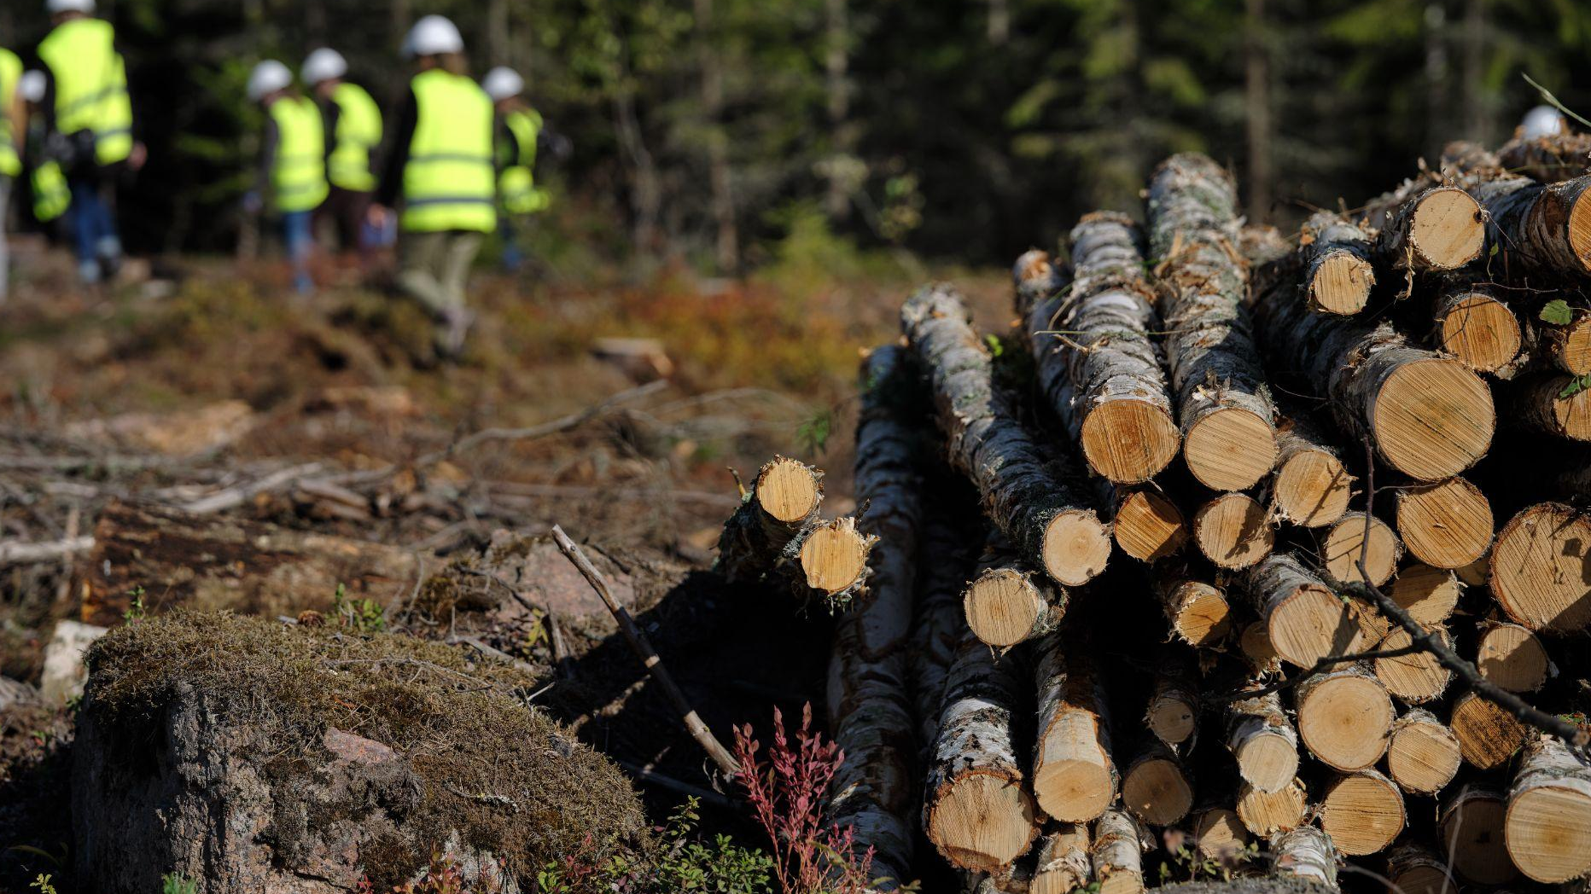
Introductions

Slide 4
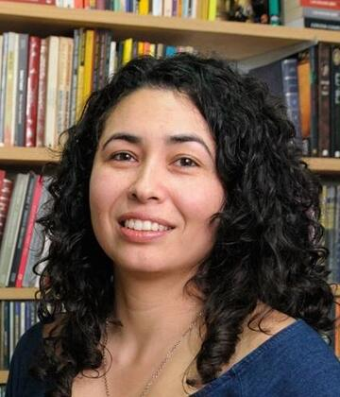
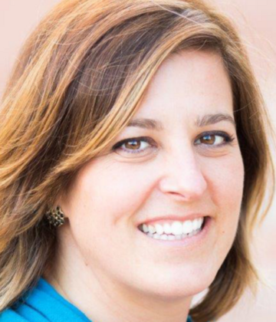
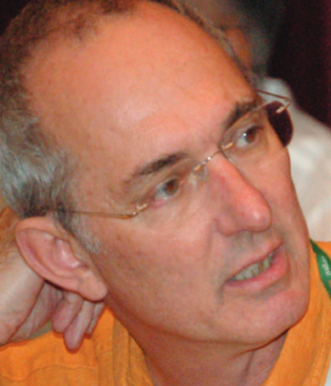
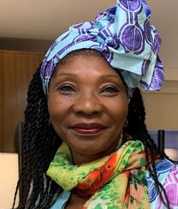
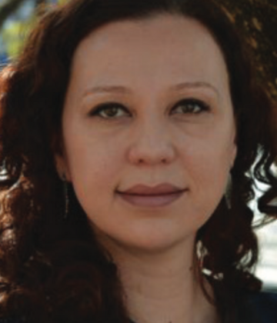
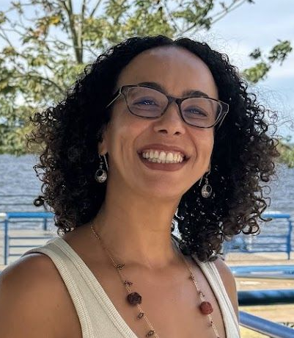
Dialogue Co-Chairs
Maurem Alves
Klabin
Kerry Cesareo
WWF
Marcus Colchester
Forest Peoples Programme
Fernanda Rodrigues
Brazilian Forests Dialogue
Erica Munaro
Bahia Forest Forum
Cécile Ndjebet
REFACOF
+ Support from the TFD Team (Logan, Isabela and Gary)
Brazil Forest Dialogue and Bahia Forest Forum(Vitor and Marcia)

Slide 5
Advisory Group Members
Maurem Alves, Klabin SA
Lyndall Bull, FAO
Kerry Cesareo, World Wildlife Fund, USA
Marcus Colchester, Forest Peoples Programme
Cécile Ndjébet, African Women’s Network for Community Management of Forests
Carolina Toapanta, Fundacion Bomaco
Alan Batista, Symbiosis
Ana Paula Kanoppa, Ibá
Daniel Piotto, Universidade Federal do Sul da Bahia
Erica Munaro, Bahia Forest Forum
Fernanda Rodrigues, Brazilian Forests Dialogue
Lyndall Bull, FAO
Márcio Braga, iNovaland Brasil
Maria Otavia Crepaldi, IPÊ
Miguel Calmon, Conservation International Brazil
Patrícia Machado, Suzano
Ruth Metzel
João Augusti, Bracell

Slide 6
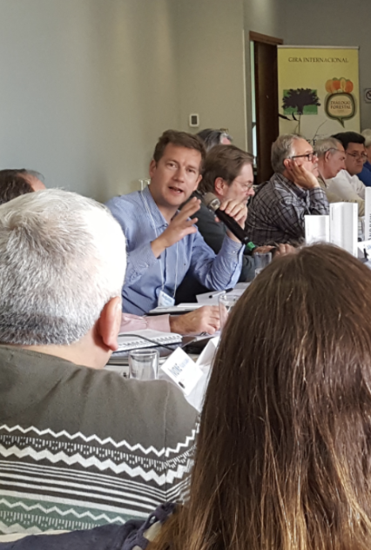
Participant Introductions
Name
Organization
Location

Slide 7
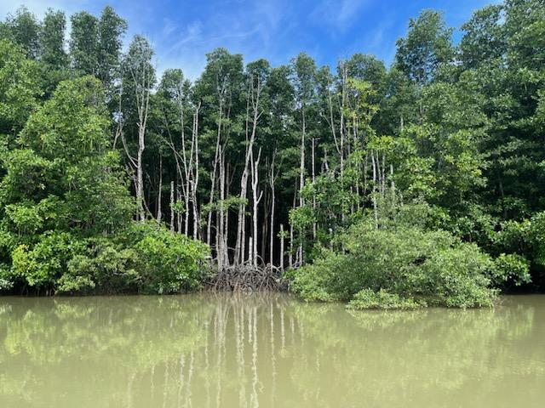
Dialogue Ground Rules

Slide 8
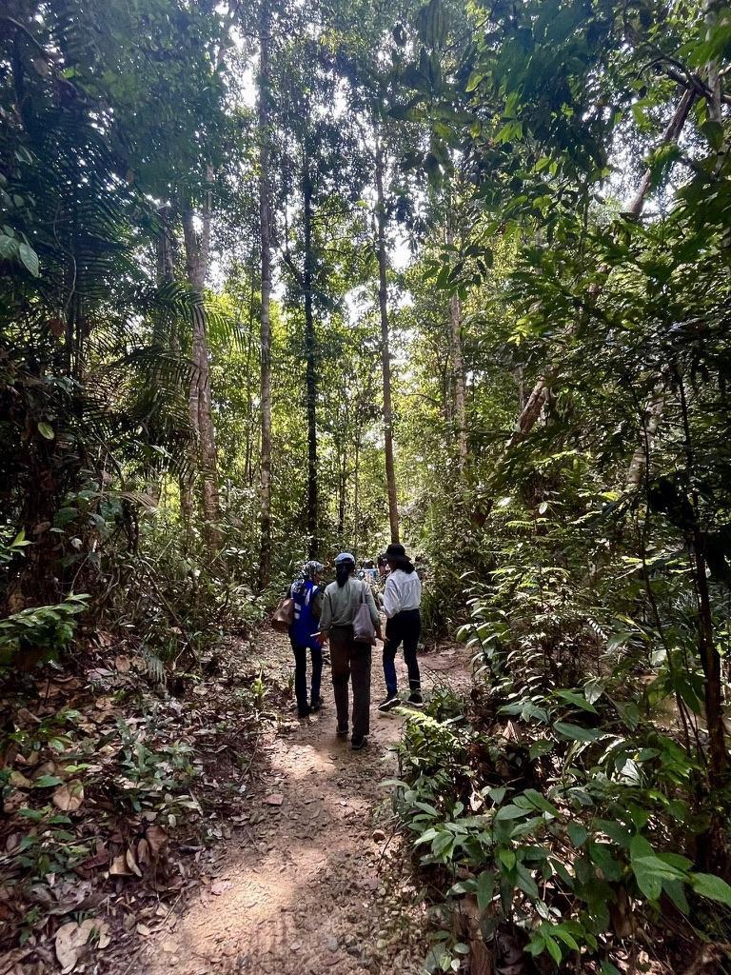
Dialogue Ground Rules
TFD operates under the Chatham House Rule
“Participants are free to use the information received, but neither the identity nor the affiliation of the speaker(s), nor that of any other participant, may be revealed.”

Slide 9
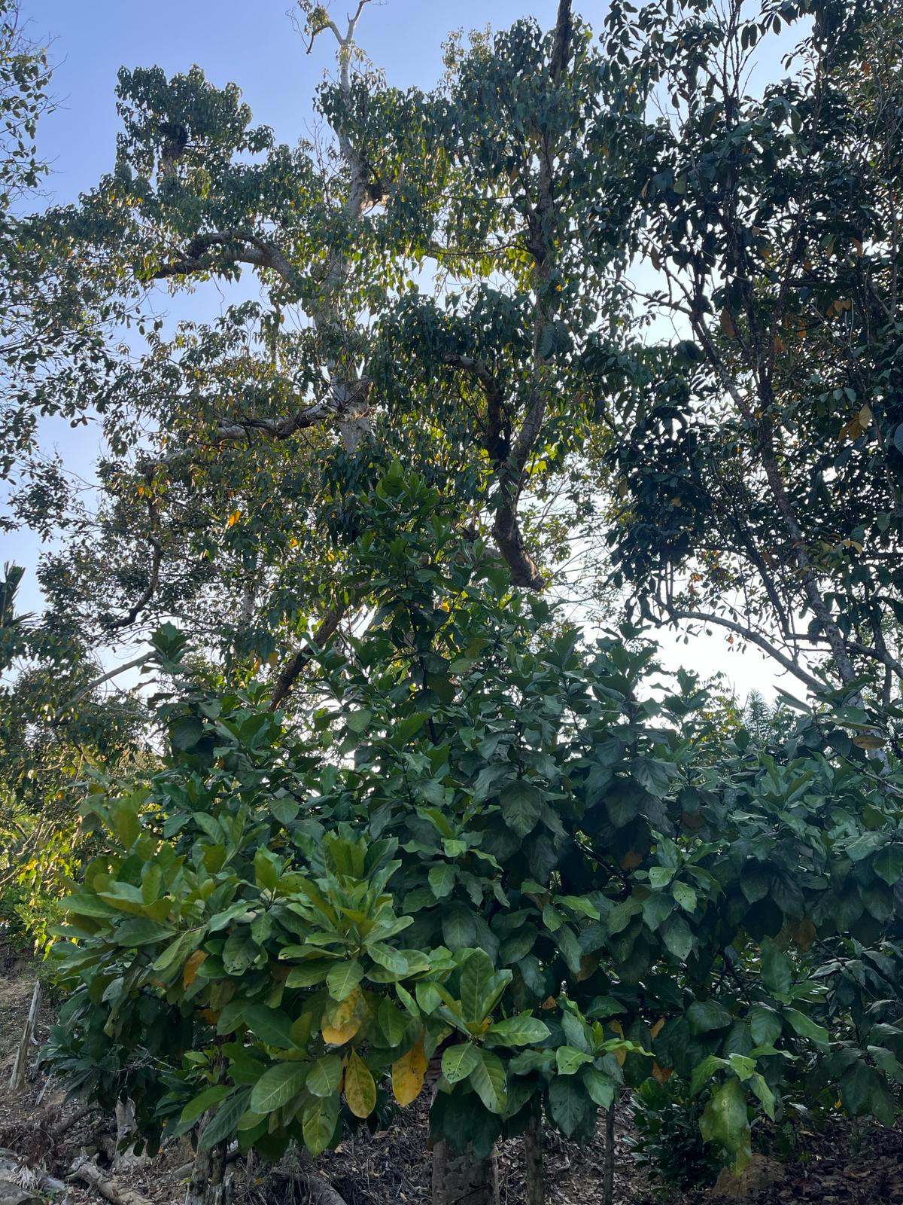
Dialogue Ground Rules
Engage in the “spirit of dialogue”
Practice active listening
Participate as individual
Take space, make space
Help define and own the outcomes
Use structured interventions in plenary- name tent

Slide 10
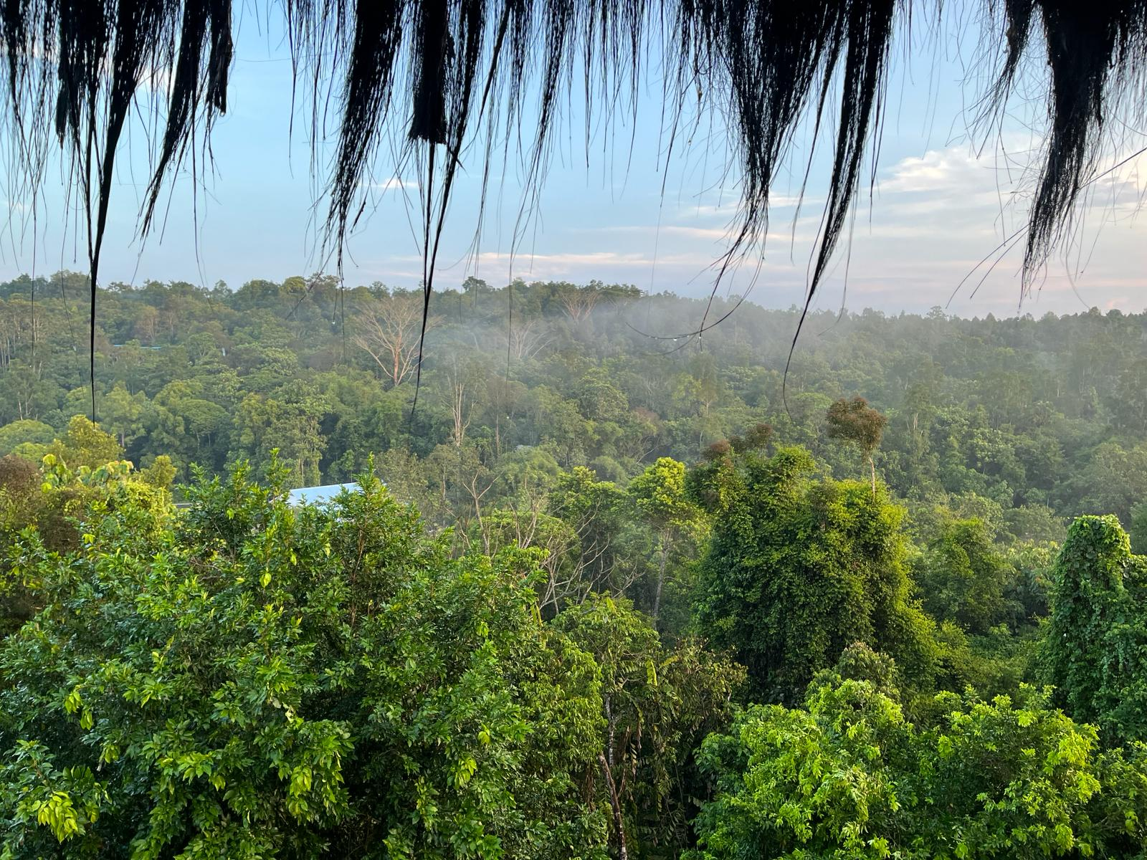
The Forests Dialogue (TFD) Overview
Notes:
Change photo- pre-visit?

Slide 11
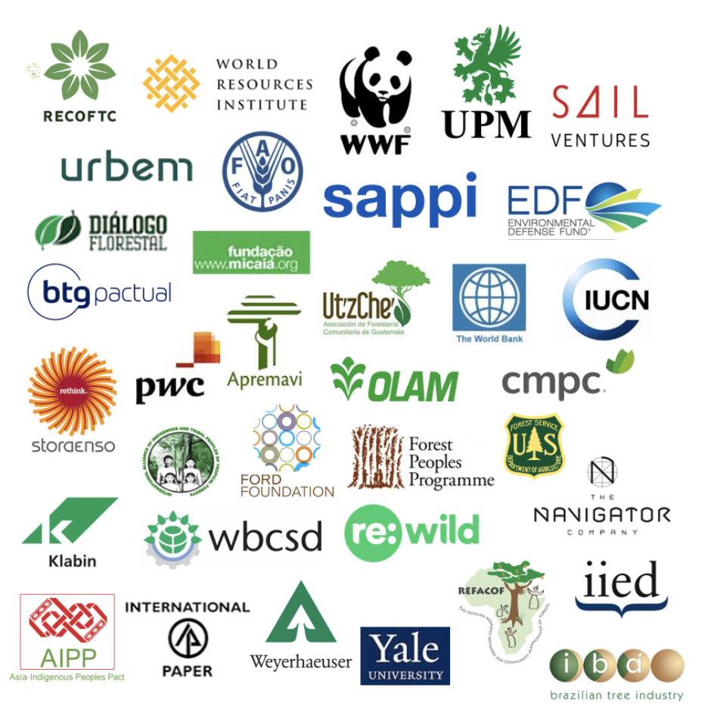
TFD Origins
Established in 2000 by NGO and Business Leaders in order to:
Reduce conflict among stakeholders;
Create an independent international platform and process to discuss key SFM and conservation issues;
Build mutual trust and enhanced understanding and commitment to change.
Notes:
Introduce TFD, tell you a bit about or origins and where we are at today.
Established, NGO (primarily large environmental organizations) and business leaders in the forest sector), initial meeting by convened by world bank, interested to have permanent platform to reduce conflict among stakeholders
Create independent platform, secretariat based at yale
since those origins : landscape scale + local communities and indigenous peoples- reflected in our logo soup which is our Steering Committee and partners
Governed by a Steering Committee, identify our initiatives, drive our dialogue process

Slide 12
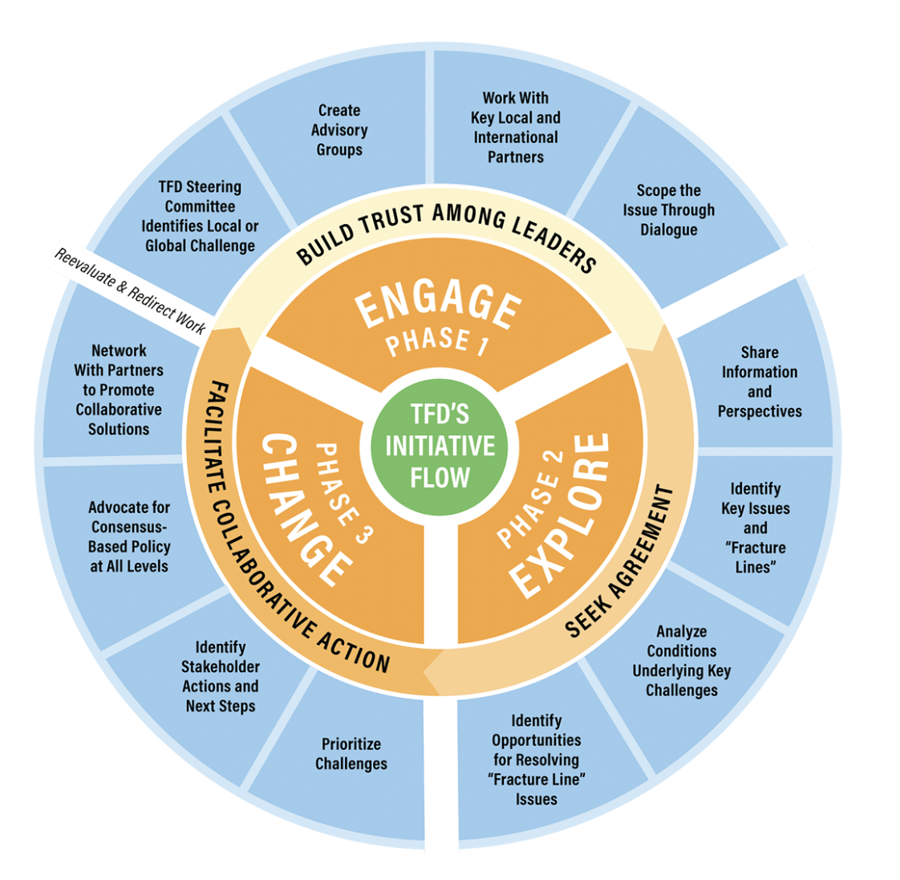
TFD Theory of Change
‘ENGAGE’: Identify key issues, build trust, share perspectives and information.
‘EXPLORE’: Seek agreement about challenges and opportunities to solve forest-related ‘fracture-lines’.
‘CHANGE’: Promote and facilitate actions that lead to solutions, with impact in policy and on the ground.
*See TFD Guide for step-by-step detail
Notes:
Not going into all the details: highlight here the explore phase…field dialogues
Change phase
More detail in brochure
change phase reflects the goals and needs identified by participants themselves
-could include catalyzing a new partnership, or organization as happened with Investing in locally controlled forestry
-or develop a framework or set of policy recommendations as happened with Understanding Deforestation Free
-also important to note change in specific places mobilized from field dialogues: establishment of the brazilian forests dialogues; or follow up dialogues between companies and impacted communities following TPL dialogue in indonesia.

Slide 13
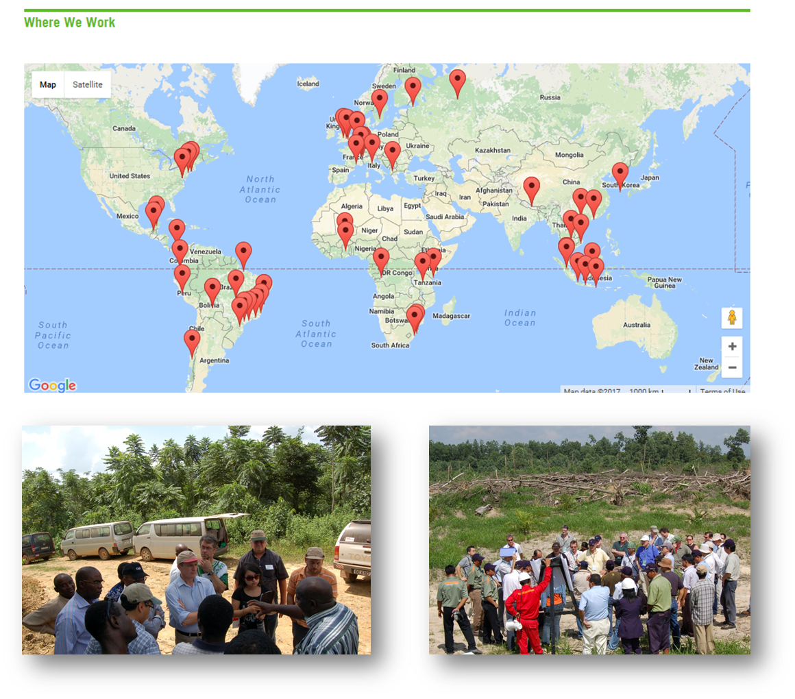
TFD By The Numbers
2000-present (26 years!)
1st dialogue in 2002 on the Future of Forest Certification
25+ different Initiatives
100+ International Dialogues
38 different countries
3000+ Stakeholders
100+ Publications
Notes:
add key outcomes of dialogues in Indonesia?
-20 initiatives
-The majority of our dialogues take place in forests and forest landscapes, all start with scoping dialogue, move into field dialogue phase
-36 different countries. 9 in Indonesia (this is our first in East Kalimantan)
-100 publications: direct outputs from our dialogues or about dialogue topics

Slide 14
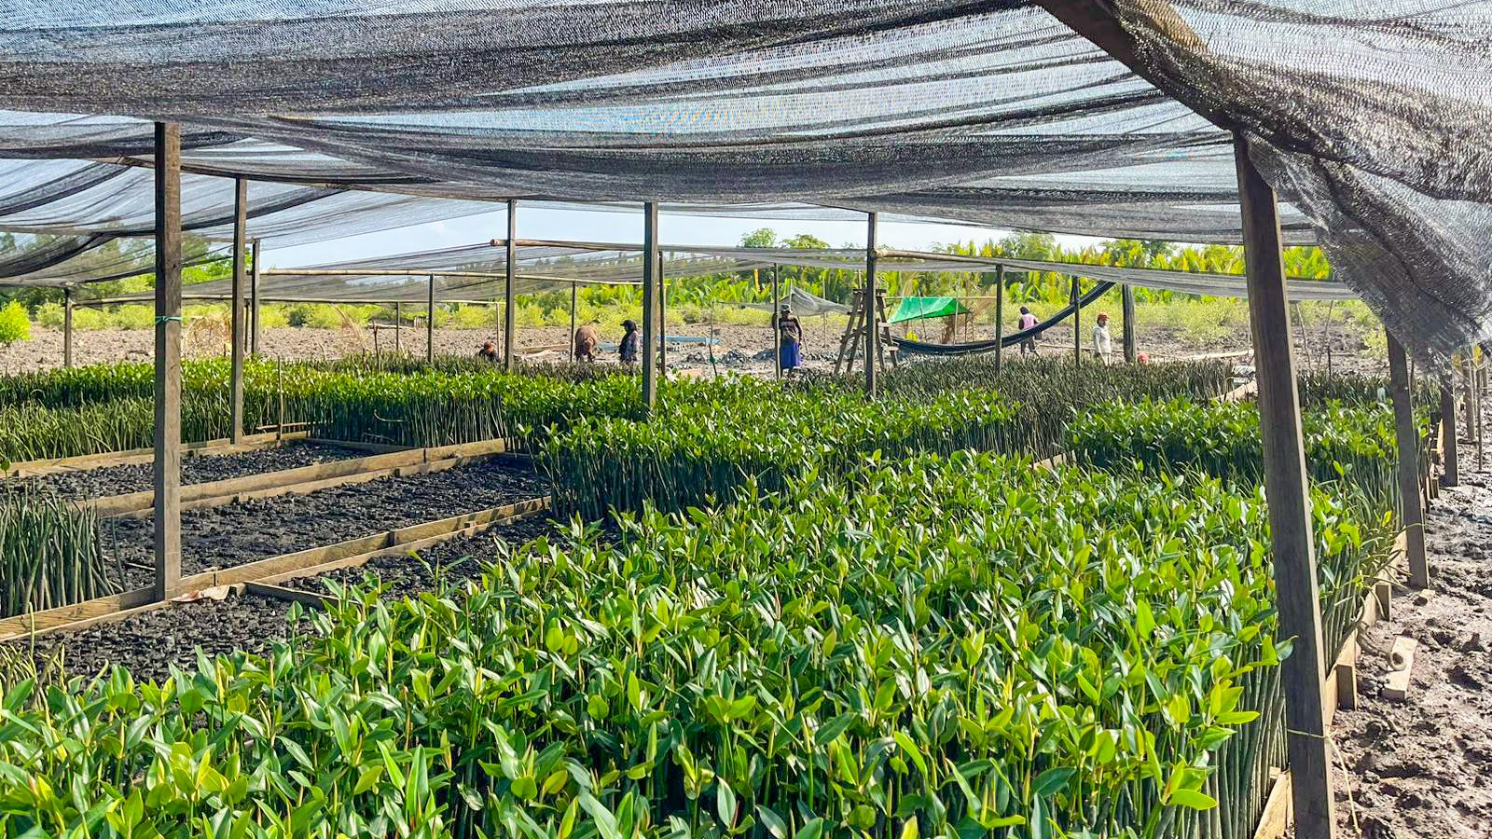
Ecosystem Restoration Initiative

Slide 15
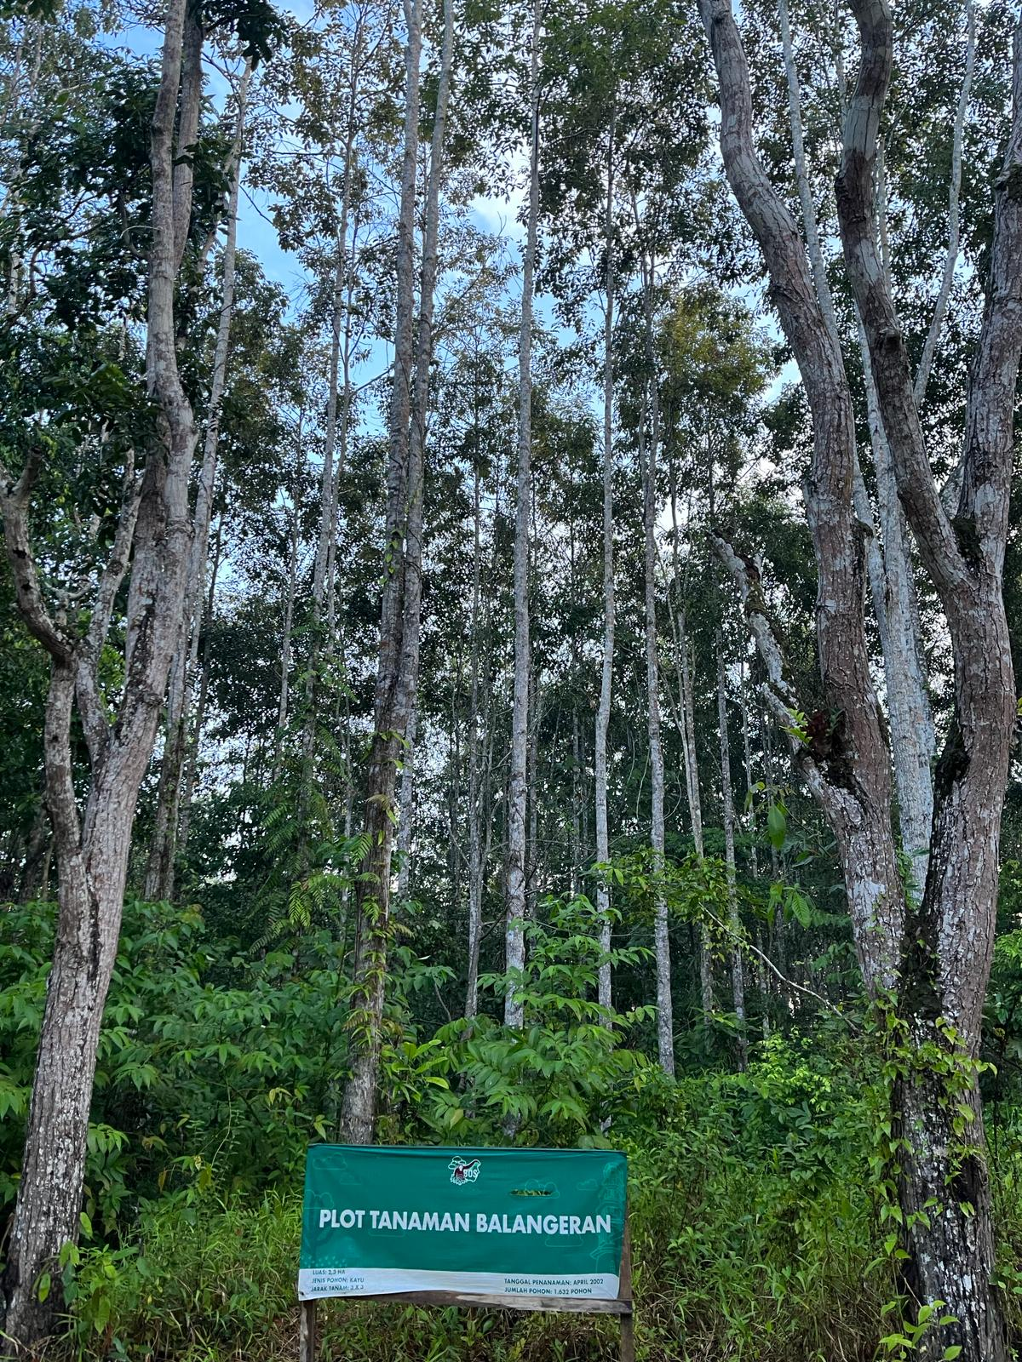
TFD’s Ecosystem Restoration Initiative
Decision to focus on the role of the forest sector and specifically the private forest sector in ecosystem restoration, including smallholders, forest industry, community forestry
In the context of the rights, roles, responsibilities opportunities of all ecosystem restoration actors and learning from other private sector actors
3
Notes:
Change photo

Slide 16
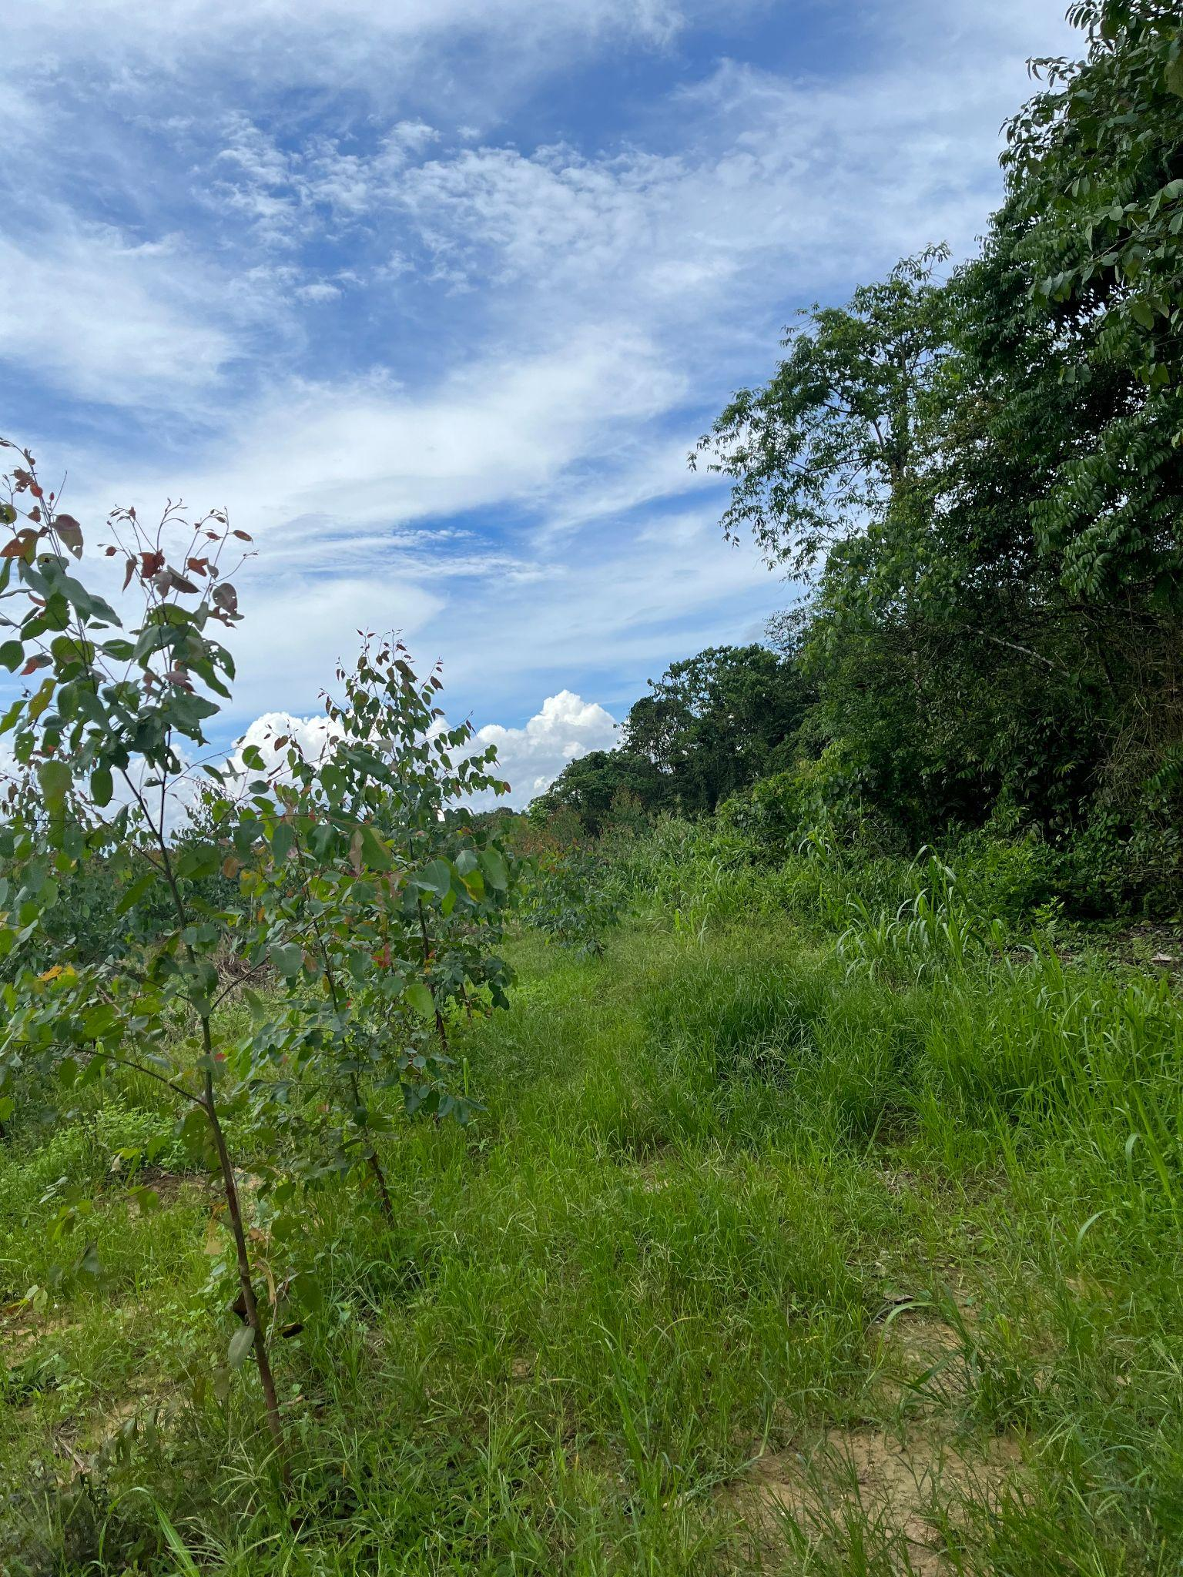
Ecosystem Restoration Initiative
So Far…
Restoration Roundtable 2022, Rome
in collaboration with ACSFI of FAO
6 priority strategies emerged: 1) build unity, 2) develop good metrics, 3) collaborate with other stakeholders, 4) understand where degraded land and forest sector capacity aligns, 5) establish new business cases 6) identify business and financial models that share value
A focus on landscape level restoration is critical for successful restoration efforts
3

Slide 17
Ecosystem Restoration Initiative
So Far…
Scoping Dialogue 2023, New Haven
Key challenges:1) Restoration Continuum, 2) Spheres of Private Sector Engagement, 3) “Carrots and Sticks”.
Prioritization and path forward: 1) holistic model integration → top-down national goals with bottom-up local decision-making; 2) establishing verifiable, site-specific baselines and metrics → utilizing documented case studies, 3) and, creation of validated business cases → incorporate both commercial forest products and non-economic benefits

Slide 18
Ecosystem Restoration Initiative
So Far…
Field Dialogue 2024, Kalimantan
Key Fracture Lines: Carbon vs. Biodiversity Markets; Economic Drivers vs. Ecological/Social Needs; Top-Down Targets vs. Bottom-Up Reality; Restoration vs. Conservation Incentives
Post-Mining Reclamation. Takeaway: While technically successful at stabilization, these projects often lack community engagement and highlight a need for better compensation mechanisms for surrounding local populations.
Community Mangrove Enterprises: Small-scale nurseries transitioned from basic restoration to successful non-timber forest product (NTFP) and ecotourism businesses. Takeaway: Restoration is more sustainable when it is community-led and provides direct economic independence.

Slide 19
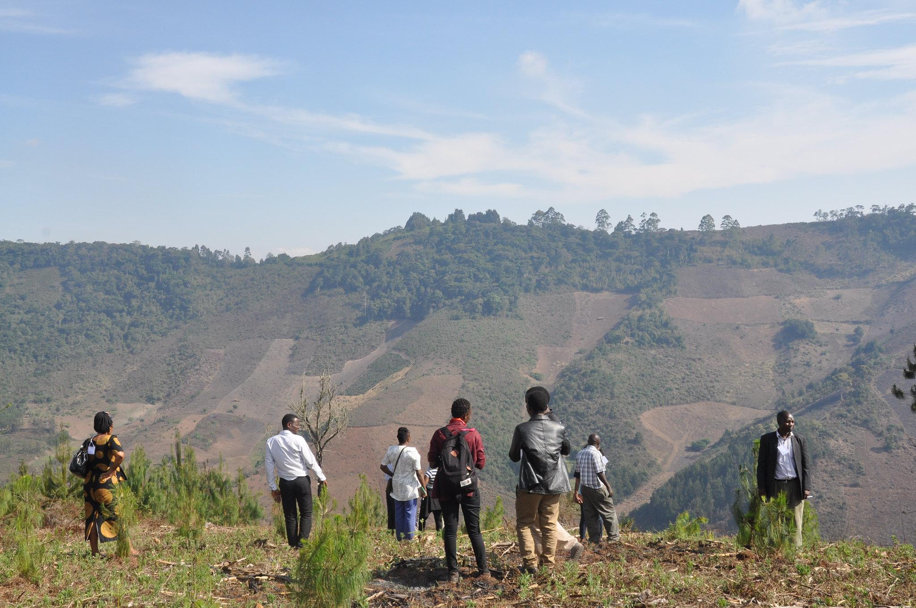
Brazil Dialogue Objectives
Clarify ecosystem restoration needs and engage a broader range of stakeholders in Bahia.
Understand how the private sector can better support forest restoration and increase engagement.
Explore collaboration opportunities to co-create successful ecosystem restoration approaches.
Explore successful cases of partnerships between companies and communities, political support and clearer policies, new financing models, recognition of traditional rights and greater inclusion of Indigenous Peoples and women.
Examining the key success factors and challenges within the local context.
Notes:
private forest sector, NGO, academia, investment and intergovernmental organizations

Slide 20
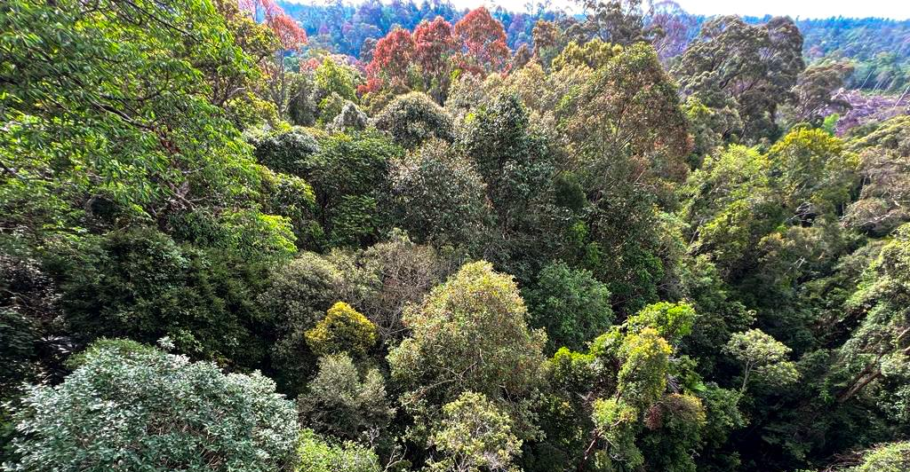
Background Paper

Slide 21
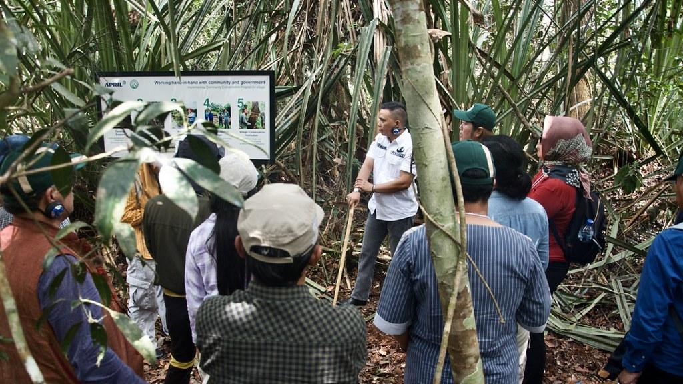
Field Visits Overview

