Slide 1
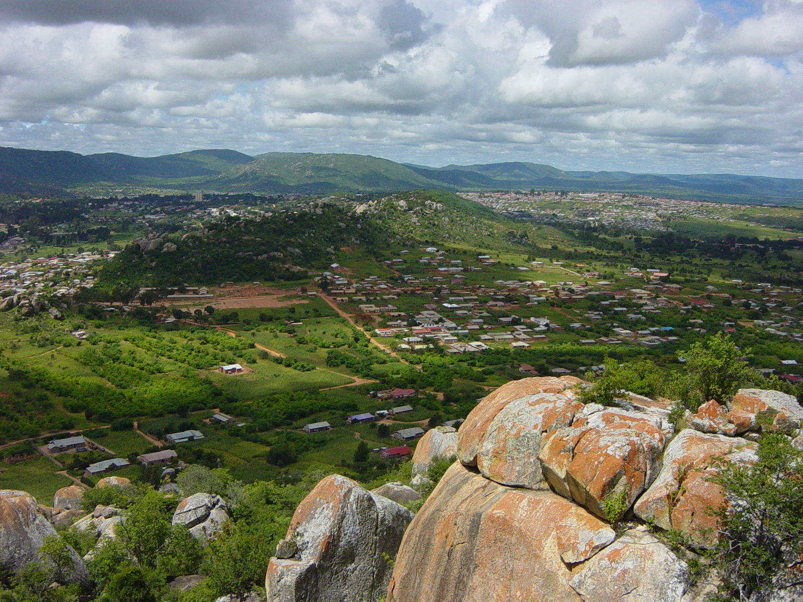
Monitoring & Evaluating the LUD, Iringa, Tanzania
November 2016

Slide 2
Representative Neutral Trustworthy
Evaluation of the LUD
Who participated in the LUD
Who answered the survey
The platform represents all relevant stakeholders in the landscape
All members participate and are heard in discussion
Members have the necessary knowledge and skills to participate in the dialogue
Members feel welcome, informed and encouraged to contribute
Stakeholder Mapping
Social Network Mapping

Slide 3
Evaluation of the LUD

Slide 4
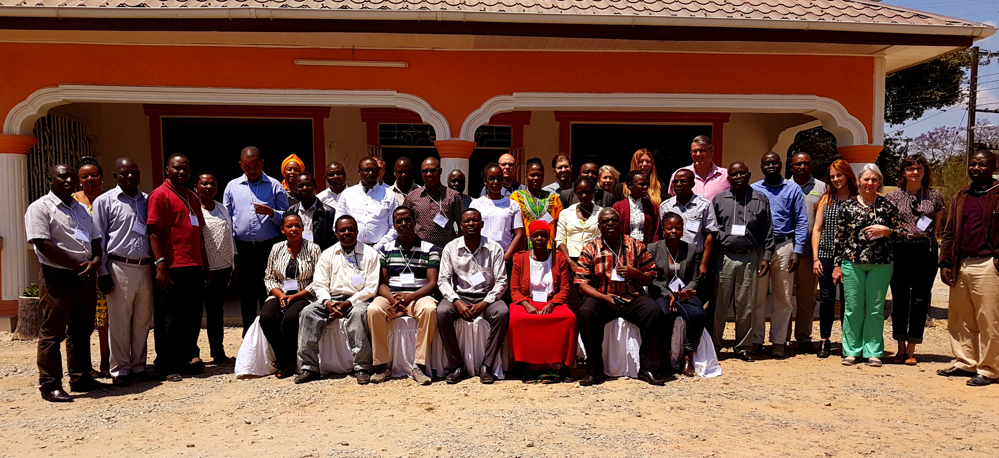
Who participated in the LUD

Slide 5
Who answered the survey? 43% response rate

Slide 6
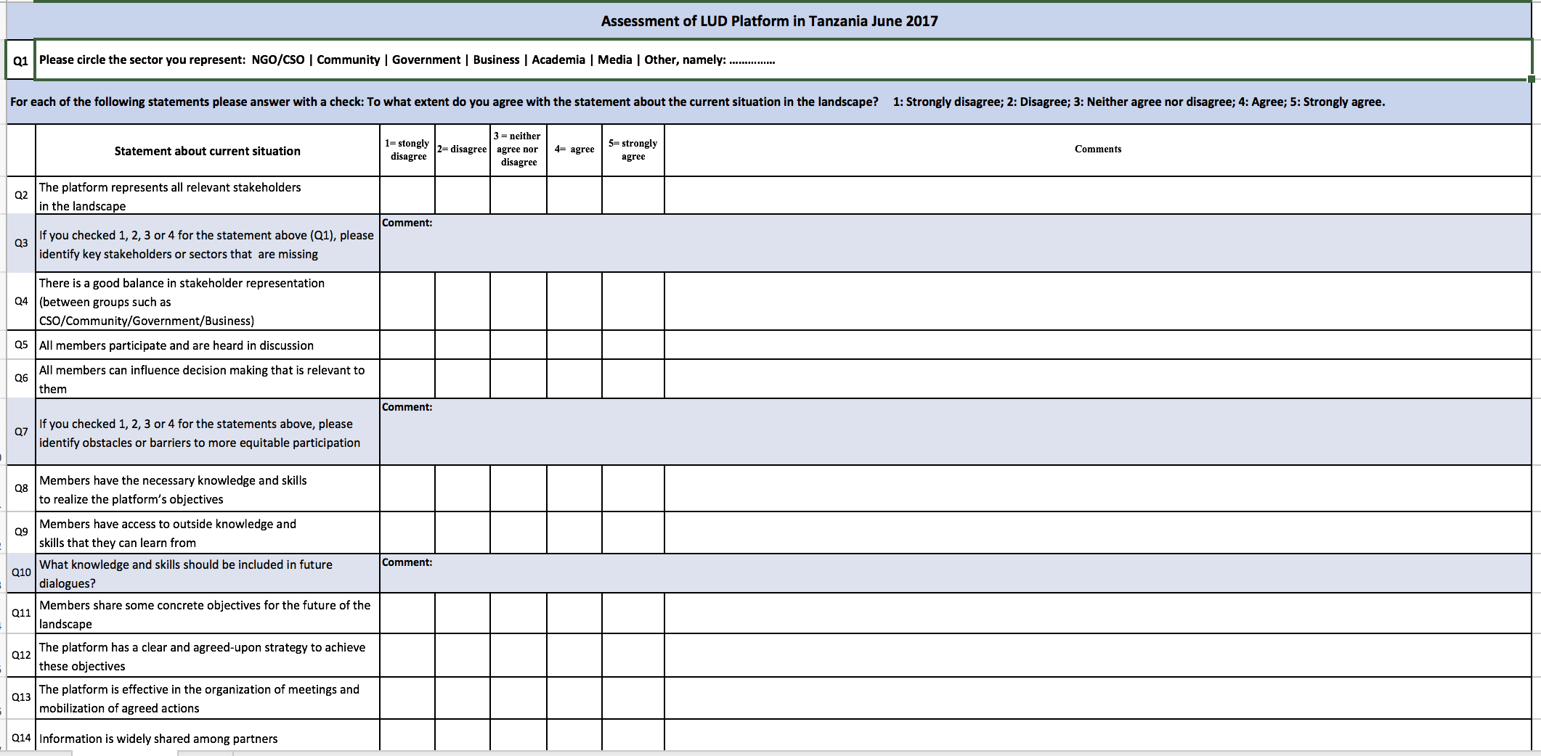
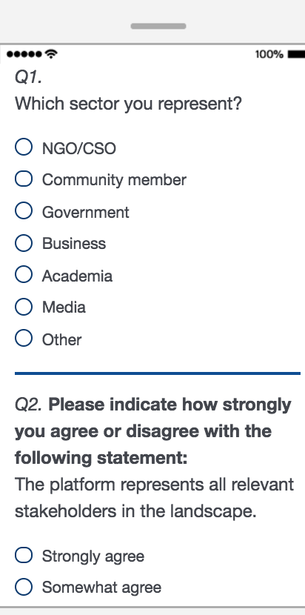
Pleaser answer the LUD Assessment Survey on Wednesday!!!
PAPER
ONLINE

Slide 7
The platform represents all relevant stakeholders in the landscape

Slide 8
Need more representation from
pastoralist
village leaders

Slide 9
All members participate and are heard in discussion

Slide 10
Barriers to discussion
language barriers
funding

Slide 11
Members have the necessary knowledge and skills to participate in the dialogue

Slide 12
Need more information about
gender issues
community development
indigenous knowledge
business management

Slide 13
Members feel welcome, informed and encouraged to contribute

Slide 14
Stakeholder Mapping

Slide 15
Are stakeholders missing? Please add them!
Did you attend and is the ✓ missing? Please add it!
Are you a members of the LUD Advisory Group and it the ⭐️ missing? Please add it!

Slide 16
Social Network Mapping
Notes:
I’ll now introduce one tool that helps us understand the relationships among the LUD stakeholders.

Slide 17
Tool for understanding networks of stakeholder relationships
How groups are connected
How relationships change over time
Which organizations coalesce or connect other organizations
Notes:
Social network mapping is a tool used to understand networks of stakeholder relationships.
In this tool, the points represent different organizations, the lines represent connections between organizations. Also, organizations that work more closely together are visualized as being closer together.
By mapping connections between organizations, we can see how groups work together, how relationships can change over time, and understand if there are patterns in different relationships.
With the LUD we are using this tool to try to understand how groups are connected, and how those relationships change over time. By doing this we can see how involvement in the LUD impacts network connections.

Slide 18
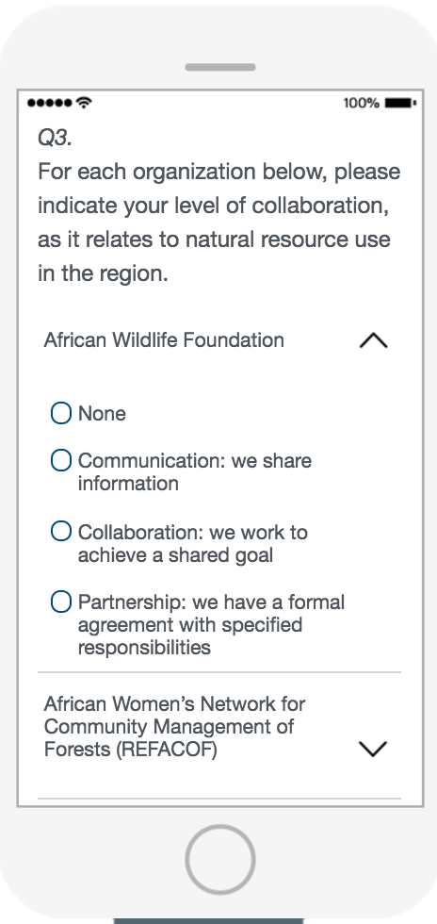
Answer the survey (available Wednesday)
Notes:
[Screenshot of Survey]
Everyone answered how they worked with every other organization represented at the LUD using this survey. We have it set up outside so you can answer it too! The survey categorizes relationships between organizations as ‘None,’ ‘Communication,’ ‘Partnership,’ and ‘Collaboration’

Slide 19
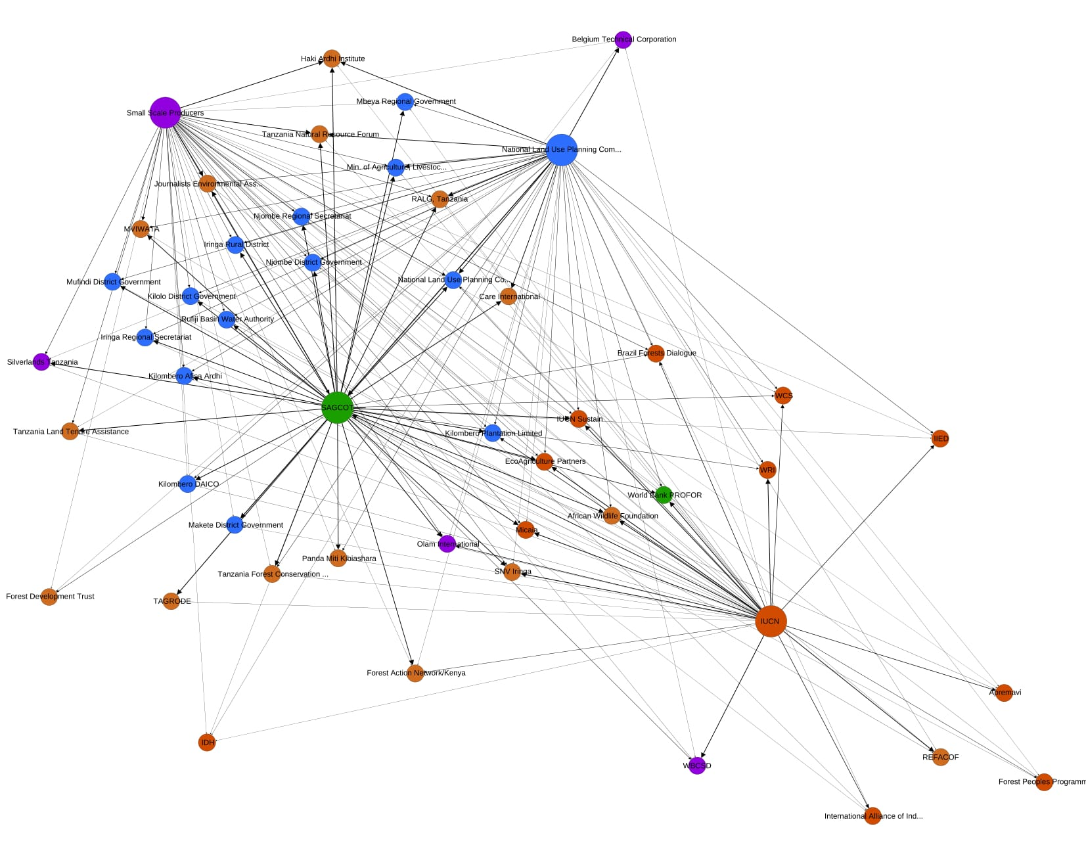
LUD Tanzania Social Network Map
Notes:
This map of relationships is the result of the answers we received from the previous dialogue. What you’re seeing is only a snapshot of the full picture because we did not have responses for every organization. So if you see that your organization is not connected, it’s just because we did not get a response from your organization.
So in this graphic each organization is connected to every organization that they work with. The different colors represent different sectors. Organizations that are closer together are those that collaborate more closely.
But looking at it like this can be a bit overwhelming, and hard to see the connections. Therefore, throughout the dialogue we will have a laptop outside with an interactive version of the network, that you all will be able to explore and see the relationships between stakeholders at the LUD.

Slide 20
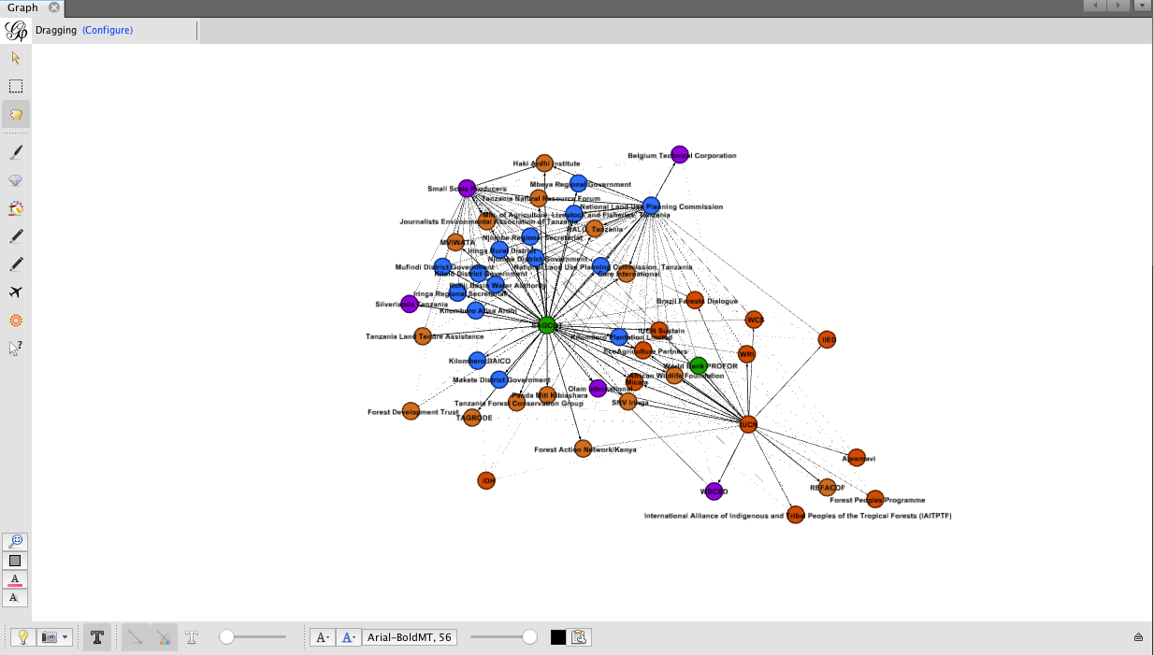
Interactive Demonstration
Notes:
If you go outside here is what you will see on the laptop. This is a program called Gephi that we used to create the network map.:
The good thing about this is that we can zoom in to understand specific relationships. Here you’ll see that as we highlight specific organizations, we can see which other groups they are connected with. Again, remember, this is just based on the responses we received from the first LUD. If you want your organization’s relationships represented here just fill out the survey, which will be on a laptop right next to this demonstration site.
From this diagram, we can understand how relationships change over time, which groups are most central to the network, and understand how organizations are connected to other groups.

Slide 21
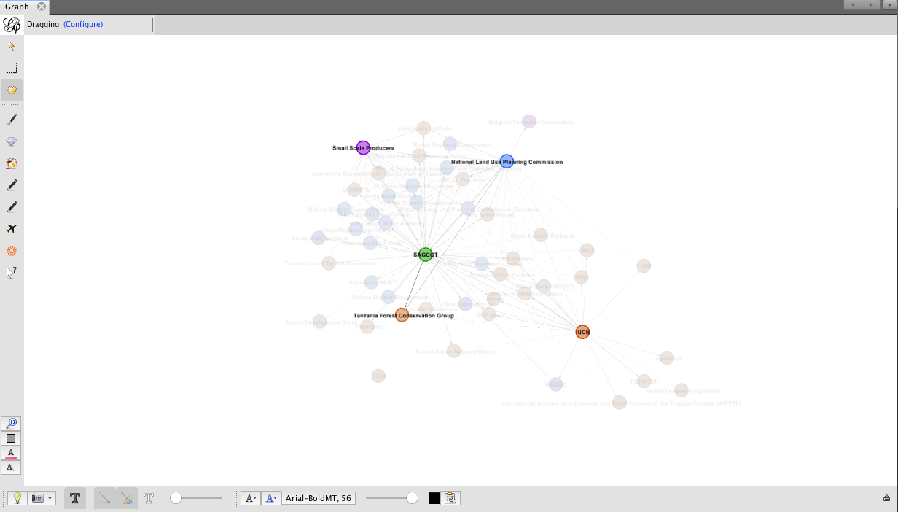
Interactive Demonstration
Notes:
If you go outside here is what you will see on the laptop. This is a program called Gephi that we used to create the network map.:
The good thing about this is that we can zoom in to understand specific relationships. Here you’ll see that as we highlight specific organizations, we can see which other groups they are connected with. Again, remember, this is just based on the responses we received from the first LUD. If you want your organization’s relationships represented here just fill out the survey, which will be on a laptop right next to this demonstration site.
From this diagram, we can understand how relationships change over time, which groups are most central to the network, and understand how organizations are connected to other groups.

Slide 22
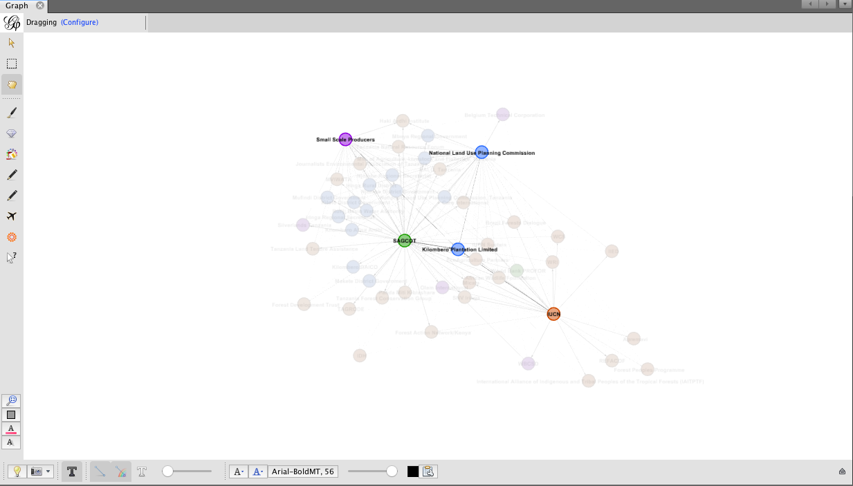
Interactive Demonstration
Notes:
If you go outside here is what you will see on the laptop. This is a program called Gephi that we used to create the network map.:
The good thing about this is that we can zoom in to understand specific relationships. Here you’ll see that as we highlight specific organizations, we can see which other groups they are connected with. Again, remember, this is just based on the responses we received from the first LUD. If you want your organization’s relationships represented here just fill out the survey, which will be on a laptop right next to this demonstration site.
From this diagram, we can understand how relationships change over time, which groups are most central to the network, and understand how organizations are connected to other groups.

