Slide 1

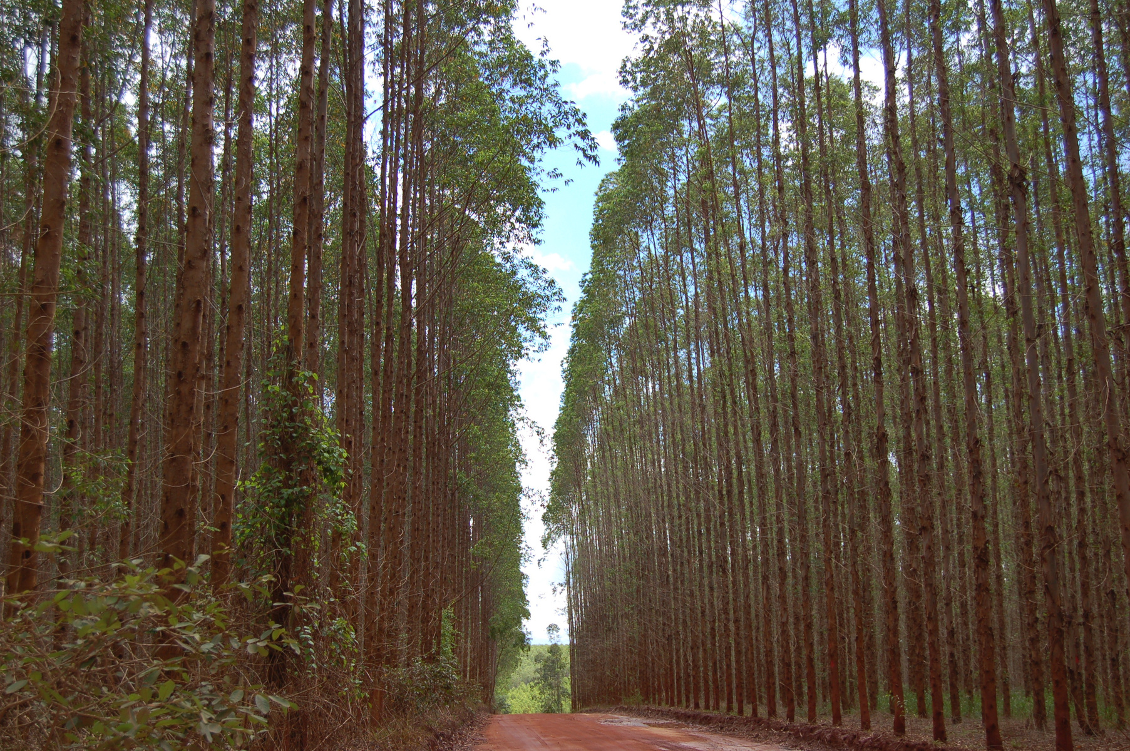
TFD IMPACT
STORIES
Private Sector Partnerships in The Forests Dialogue
BUILDING TRUST AND DIALOGUE
​​
Since its founding, The Forests Dialogue (TFD) has played a pivotal role in reshaping how private sector companies approach complex challenges in the forestry sector. Through its unique dialogue model, TFD assists companies in integrating meaningful multi-stakeholder engagement into their operations in forested landscapes, where conflict and complexity require collaboration across sectors.
Antti Marjokorpi, VP of Forest Sustainability at Stora Enso, matched this understanding of TFDs crucial role: “TFD provides a safe and inclusive space for discussing core challenges. It brings together a broad variety of stakeholders, and it diversifies the views on key fracture lines in the discourse.” For many companies, TFD offers a platform to deepen understanding, build trust, and navigate tension in ways that wouldn’t otherwise be possible.
TFD continues its long history of engaging the plantation forestry sector through initiatives designed to address the evolving role of planted forests, both in local landscapes and global supply chains. From 2005 to 2008, TFD led the Intensively Managed Planted Forests (IMPF) initiative, which brought together stakeholders across Brazil, China, and Indonesia to identify how plantation projects could deliver not just economic benefits, but also social equity and environmental services. Building on those foundations, the Tree Plantations in the Landscape (TPL) initiative was launched in 2015 to explore new and emerging challenges—such as land tenure, biodiversity loss, inclusive governance, and climate resilience—within the broader landscape context.
Dialogues in countries including, but not limited to, Chile, Brazil, New Zealand, and Indonesia have focused on how tree plantations can better coexist with diverse land uses and values, integrating perspectives from
Intensively Managed Planted Forests Dialogue in Brazil 2008

Slide 2

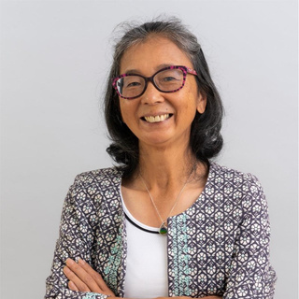
TFD IMPACT STORIES
|
October 2025
Intensively Managed Planted Forests Dialogue in China 2006
private companies, Indigenous communities, local governments, NGOs, and researchers. These efforts catalyzed changes in both corporate practice and community engagement, fostering more collaborative and context-responsive plantation forestry.
For Klabin, one of Brazil’s largest forestry companies, their involvement with TFD has directly informed how the company operates. Reflecting on Klabin’s journey, Ivone Namikawa—former TFD Steering Committee Co-Chair and Forest Sustainability Coordinator—shared, “the knowledge that was acquired was applied in other relationships inside of the company.”
Having expanded into several regions in Brazil since becoming involved with TFD, Namikawa noted how the company’s engagement with dialogue shaped interactions with stakeholders in new landscapes: “Klabin built a network with
stakeholders. Before, our operations were much more focused on negotiations. But when you have the opportunity to involve several different
actors, different stakeholders, we can come to solutions that are important for everyone.” Through Klabin’s shift toward engaging others as equal partners rather than adversaries or
beneficiaries, Namikawa believes these principles continue to foster collaborative relationships and drive long-lasting solutions of quality.
This transformation has had tangible impacts on Klabin’s relationships with Indigenous communities, NGOs, and other actors in the
The Forests Dialogue
| The Value of TFD for the Private Sector
Page 2

Slide 3
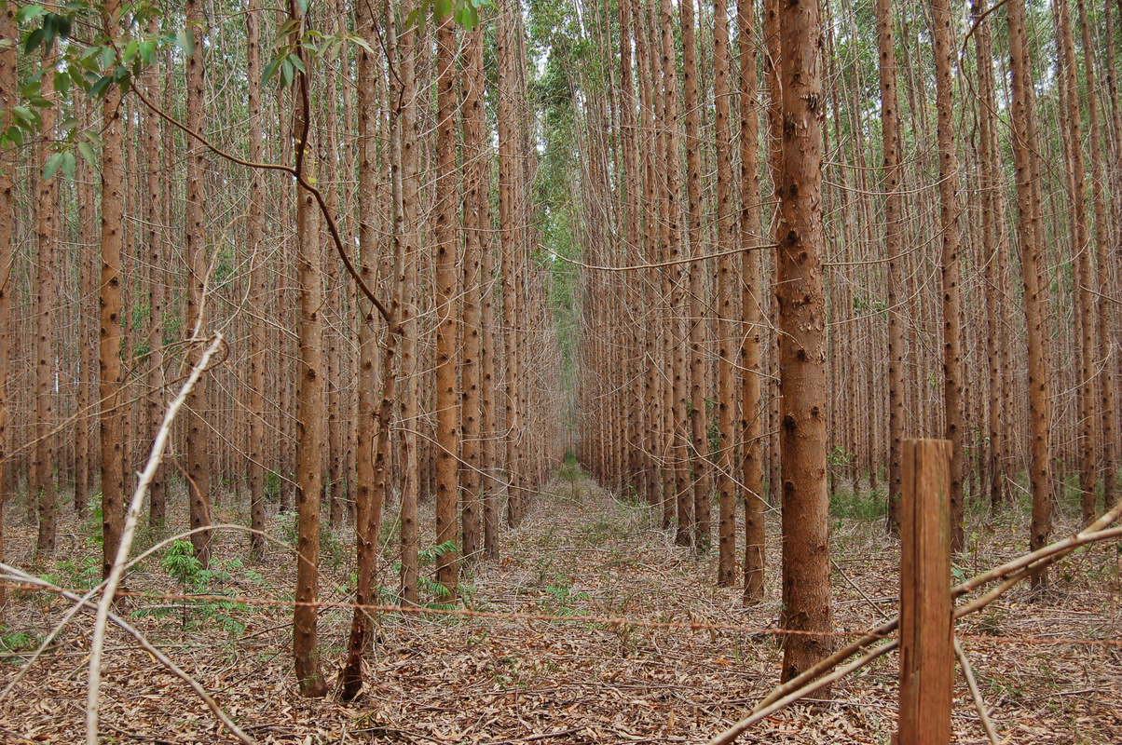
TFD IMPACT STORIES
|
October 2025
Intensively Managed Planted Forests Dialogue in Brazil 2008
landscape. Relationships between NGOs and the private sector in Brazil have evolved since TFD’s first dialogue in Brazil on Biodiversity Conservation and the founding of the Brazilian Forests Dialogue (Diálogo Florestal). Once perceived as actors with conflicting objectives, NGOs and private companies have begun to emphasize shared values such as restoration, conservation, and education. Namikawa highlighted a long-term partnership with the environmental NGO Apremavi that began through TFD:
Klabin’s experience reflects a broader trend among private forestry companies engaging with TFD. As Francisco Rodríguez, Private Consultant in Ecosystem Restoration, Forest Certifications and Plant Propagation, shared “TFD [is] a platform for the exchange of diverse experiences associated with the forestry sector. From these experiences, a company can learn from others how to solve its problems, but also contribute its solutions to others.”
Connecting across sectors
TFD’s value goes beyond dialogue alone—it provides access to global organizations, NGOs, and academic institutions. “TFD is an excellent platform for networking...not only with other companies, but also with NGOs with top-level global representatives like WWF and IUCN, and organizations like the UN, WRI, FAO, and the World Bank,” Rodríguez added. He also
“You would never expect forty years ago that the Klabin director would sit at the same table as environmental activists. Today, it’s a partnership.”
– Ivone Namikaw, former TFD Steering Committee Co-Chair
The Forests Dialogue
| The Value of TFD for the Private Sector
Page 3

Slide 4
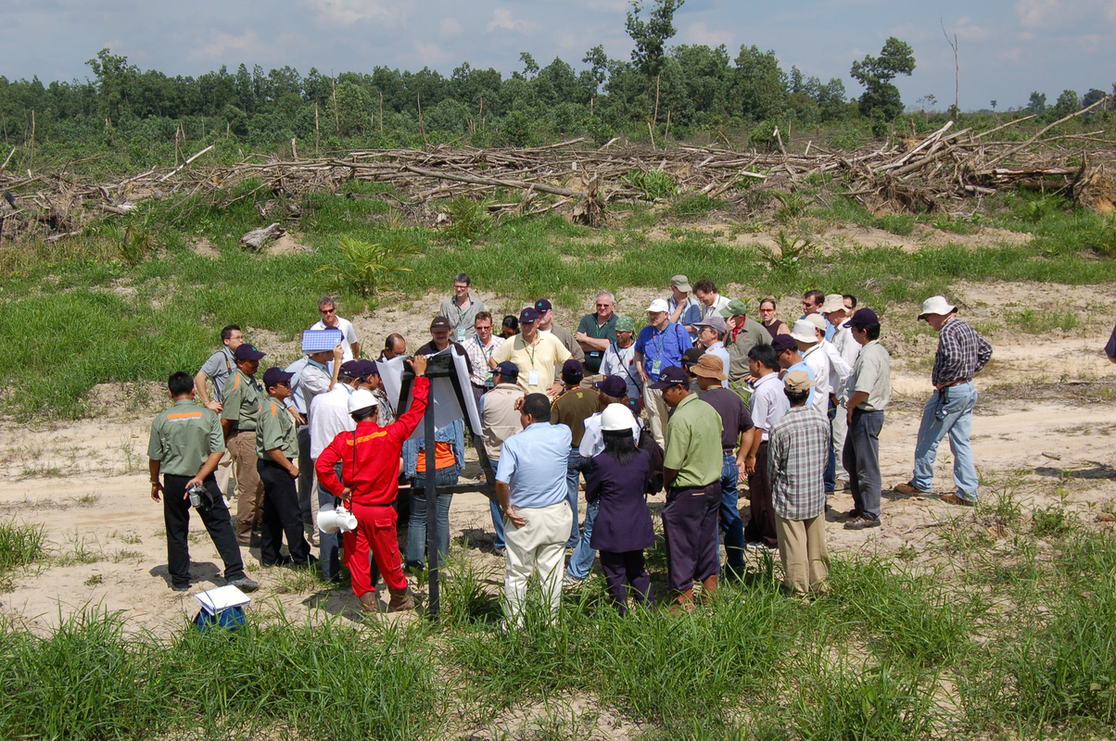
TFD IMPACT STORIES
|
October 2025
Intensively Managed Planted Forests Dialogue in Indonesia 2007
“At that time, the plantations were criticized…TFD helped reduce the conflict to a certain extent by tackling very concrete examples in the field. We went to Indonesia, Brazil, and China, brought different views to the table, and helped increase understanding.”
– Antti Marjokorpi, VP of Forest Sustainability at Stora Enso
observed during his involvement in TFD, that its connections to Yale University create unique opportunities for companies to engage in learning, contribute to academic conversations, and connect with emerging professionals who may one day join their workforce.
TFD’s impact on private sector engagement in tree plantation landscapes is also evident in its Transitions Dialogue on IMPF and TPL. Marjokorpi, who participated extensively in both dialogues, noted their significant role in diffusing tensions between different stakeholder groups.
For Marjokorpi, one of the most powerful
aspects of the TFD model is its emphasis on exploration and engagement: “Exploring helps to deepen understanding of complex issues. Engaging is essential for change.”
That spirit of engagement extended beyond the dialogues themselves. As a long-time member of TFD’s Steering Committee, Marjokorpi spoke to the value of sustained participation: “It’s kind of an observation point...where you have better visibility into all forest-related questions compared to only working within your own network.” He emphasized how hearing directly from Indigenous peoples, NGOs, and global actors helped him expand his perspective beyond the business focus—while also allowing him to bring
The Forests Dialogue
| The Value of TFD for the Private Sector
Page 4

Slide 5




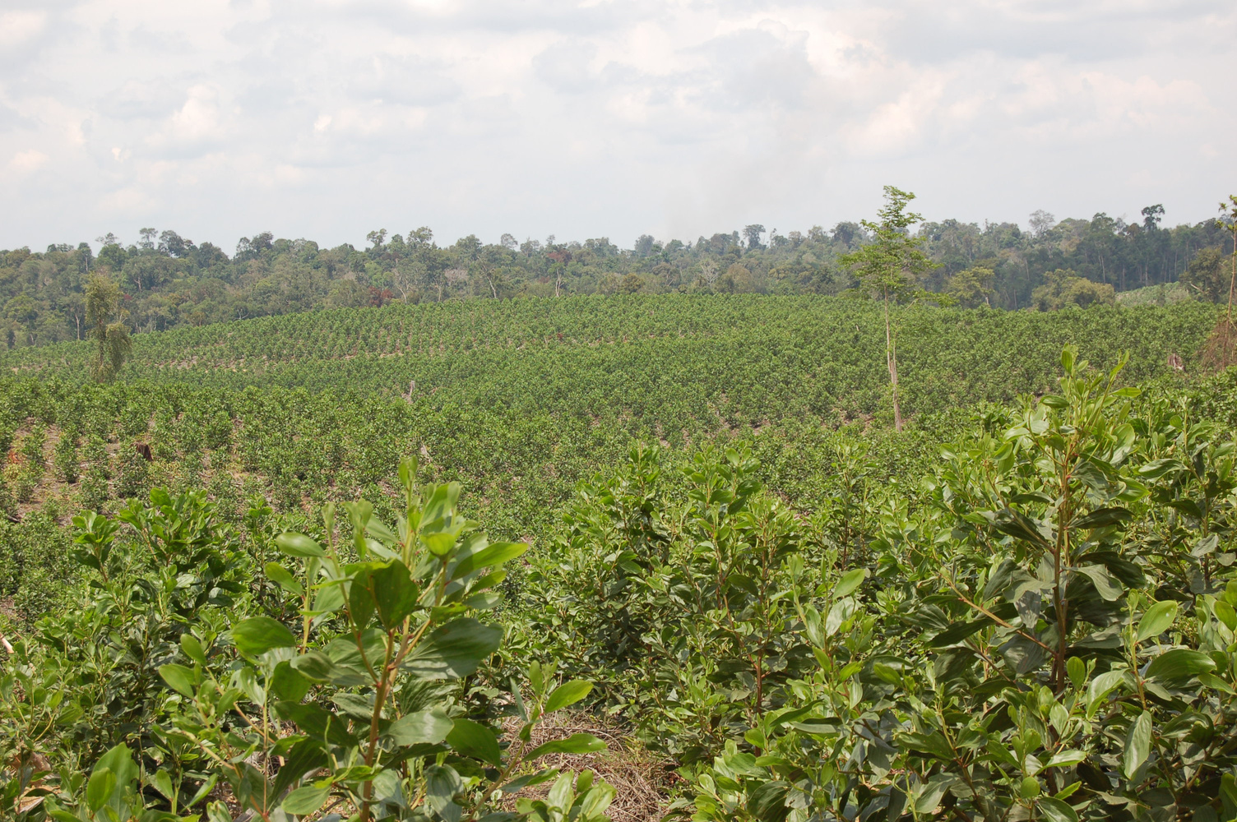
TFD IMPACT STORIES
|
October 2025
industry voices into essential conversations.
Similarly to the changes that took place in Klabin’s operations through engagement in multi-stakeholder dialogues, APRIL Group’s re-engagement with TFD after a 16-year gap underscores the long-lasting influence of the dialogue model. Internally, the dialogue had profound effects on APRIL’s corporate culture. Chris Burchmore of APRIL Group recounted how the TFD process influenced the company’s approach to stakeholder engagement, noting that the multi-stakeholder dialogue convened in Bogor, Indonesia would likely not have happened had they not reengaged with TFD a year prior.
Looking to the future, Marjokorpi sees a need for TFD to continue evolving alongside the forestry sector. As he put it, “to tackle climate change, it’s not enough to cover forests only—you need
to influence material systems and consumption patterns.” With mounting global attention on the role of forests in achieving climate and biodiversity goals, forest products are playing a increasingly important role in transforming fossil-fuel-intensive, non-renewable value chains into more sustainable systems based on renewable materials.
The experiences of companies like Stora Enso, Klabin, and APRIL offer insight into the evolving role of private sector engagement in tree plantation landscapes. Through dialogue, companies are not only strengthening their relationships with stakeholders—they are reshaping how they define impact, accountability, and collaboration.
Follow us: Learn more:
www.theforestsdialogue.org
Intensively Managed Planted Forests Dialogue in Indonesia 2007

